Slide 1


Natural Language and Time Series Based Predictive Machine Learning In Maritime Vessel Monitoring and Predictive Analytics
- Mr. Aman Sah
https://github.com/AmanSah17/Maritime_NLU

Slide 2
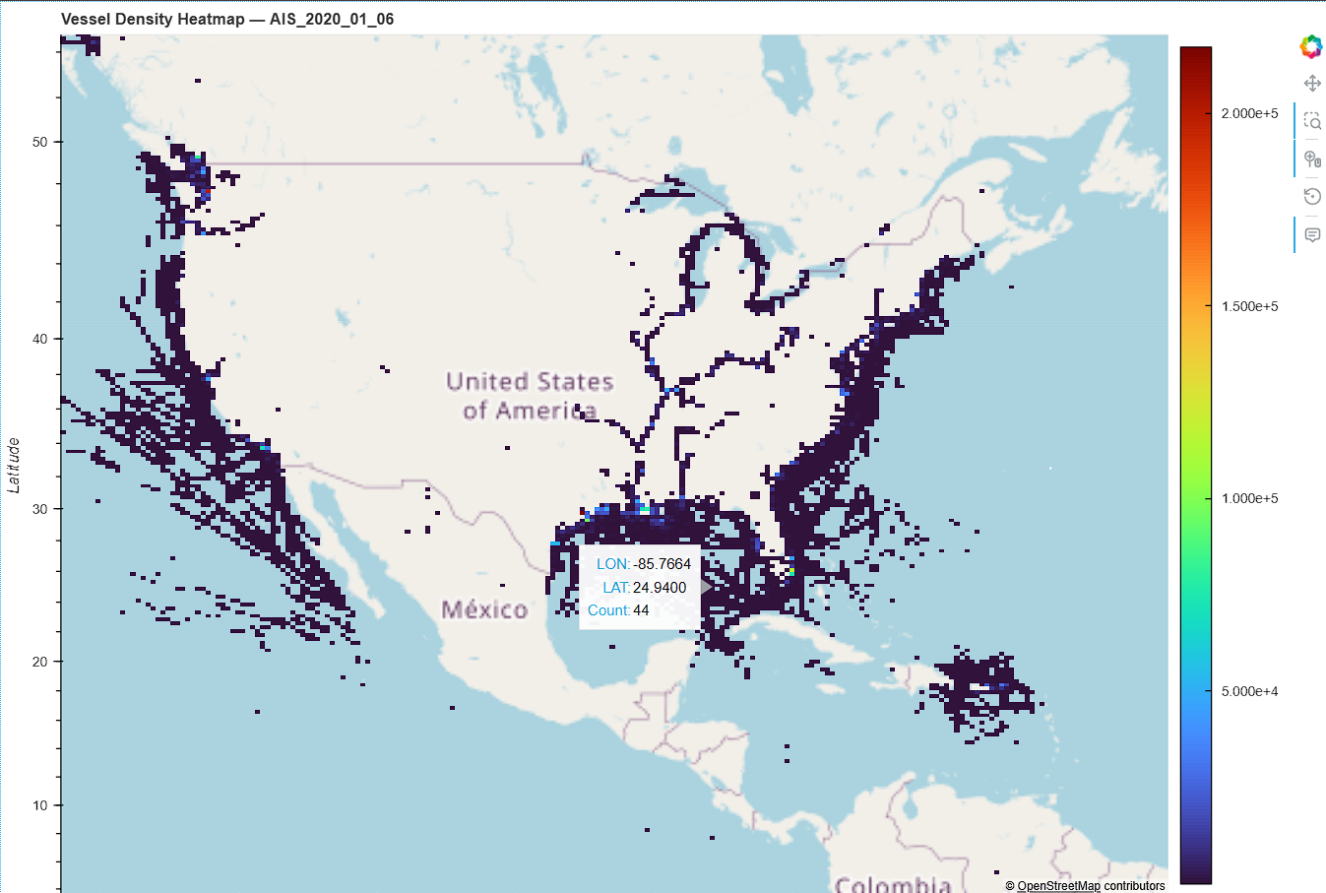
Automatic Identification System (AIS) in US Offshore Waters Vessel Traffic Data
Vessel traffic data or Automatic Identification Systems (AIS) are a navigation safety device that transmits and monitors the location and characteristics of many vessels in U.S. and international waters in real-time.
In the U.S. the Coast Guard and industry collect AIS data, which can also be used for a variety of coastal management purposes. NOAA and BOEM have worked jointly to make available these data from the U.S. Coast Guards national network of AIS receivers.

Slide 3
Maritime Mobile Service Identity (MMSI)
Maritime Mobile Service Identity (MMSI) is a unique, 9-digit number assigned to a digital selective calling (DSC) radio.
It acts as a digital fingerprint for vessels, making it easier for other boats and authorities to identify and communicate with a ship at sea quickly.
The International Telecommunications Union (ITU) in Geneva allocates, manages, and regulates MMSIs.
MMSI | BaseDateTime | LAT | LON | SOG | COG | Heading | VesselName | IMO | CallSign | VesselType | Status | Length | Width | Draft | Cargo | TransceiverClass
0 | 538008468 | 2020-01-01 00:00:00 | 38.25802 | -76.29487 | 14.9 | 338.6 | 337 | NaN | NaN | NaN | NaN | 0.0 | NaN | NaN | NaN | NaN | A
1 | 368120510 | 2020-01-01 00:00:00 | 27.58610 | -82.75991 | 0.0 | 58.6 | 511 | NaN | NaN | NaN | NaN | 0.0 | NaN | NaN | NaN | NaN | A
2 | 368063930 | 2020-01-01 00:00:00 | 40.71045 | -73.97588 | 11.2 | 208.9 | 207 | NaN | NaN | NaN | NaN | 0.0 | NaN | NaN | NaN | NaN | A
3 | 368106220 | 2020-01-01 00:00:00 | 38.53932 | -90.25523 | 0.2 | 161.8 | 31 | NaN | NaN | NaN | NaN | 15.0 | NaN | NaN | NaN | NaN | A
4 | 367336180 | 2020-01-01 00:00:00 | 56.02945 | -132.68705 | 9.0 | 325.5 | 511 | NaN | NaN | NaN | NaN | 15.0 | NaN | NaN | NaN | NaN | A

Slide 4
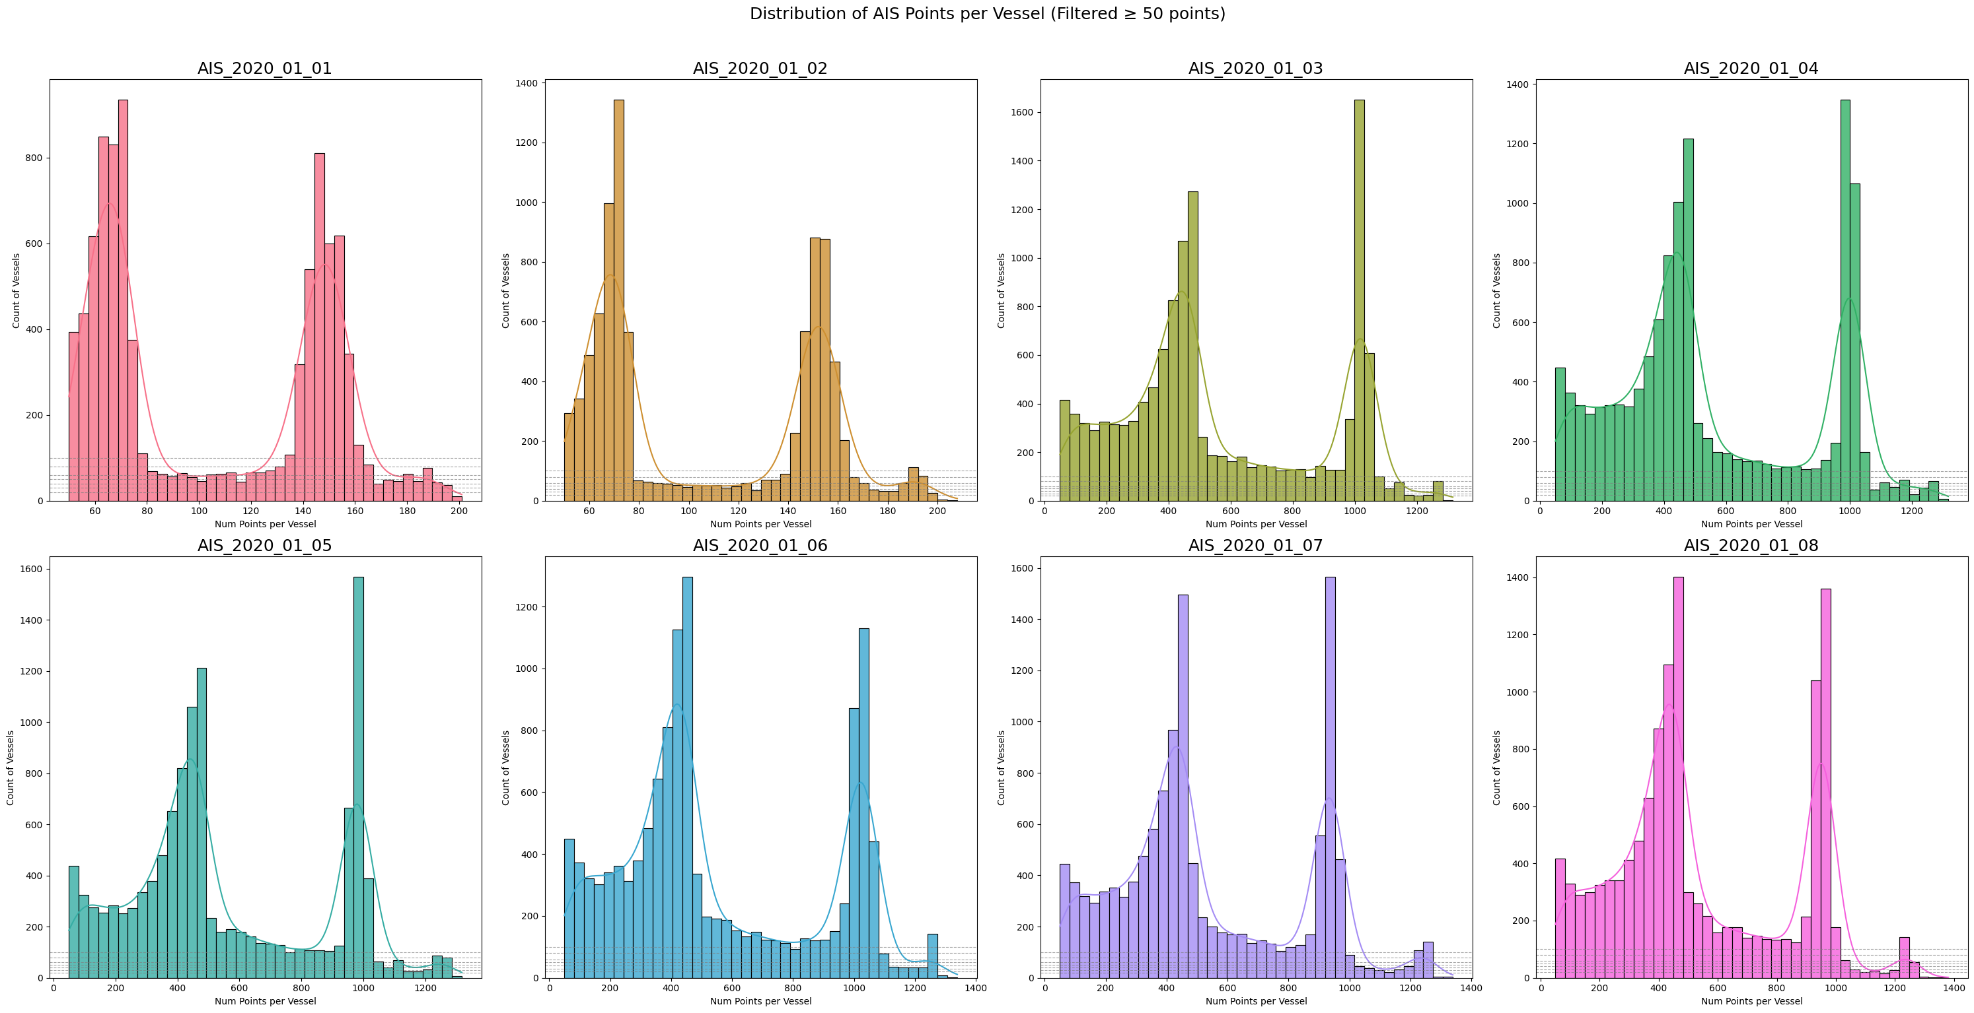
Visualization of Vessel Distribution per day-wise using the Unique MMSI :

Slide 5
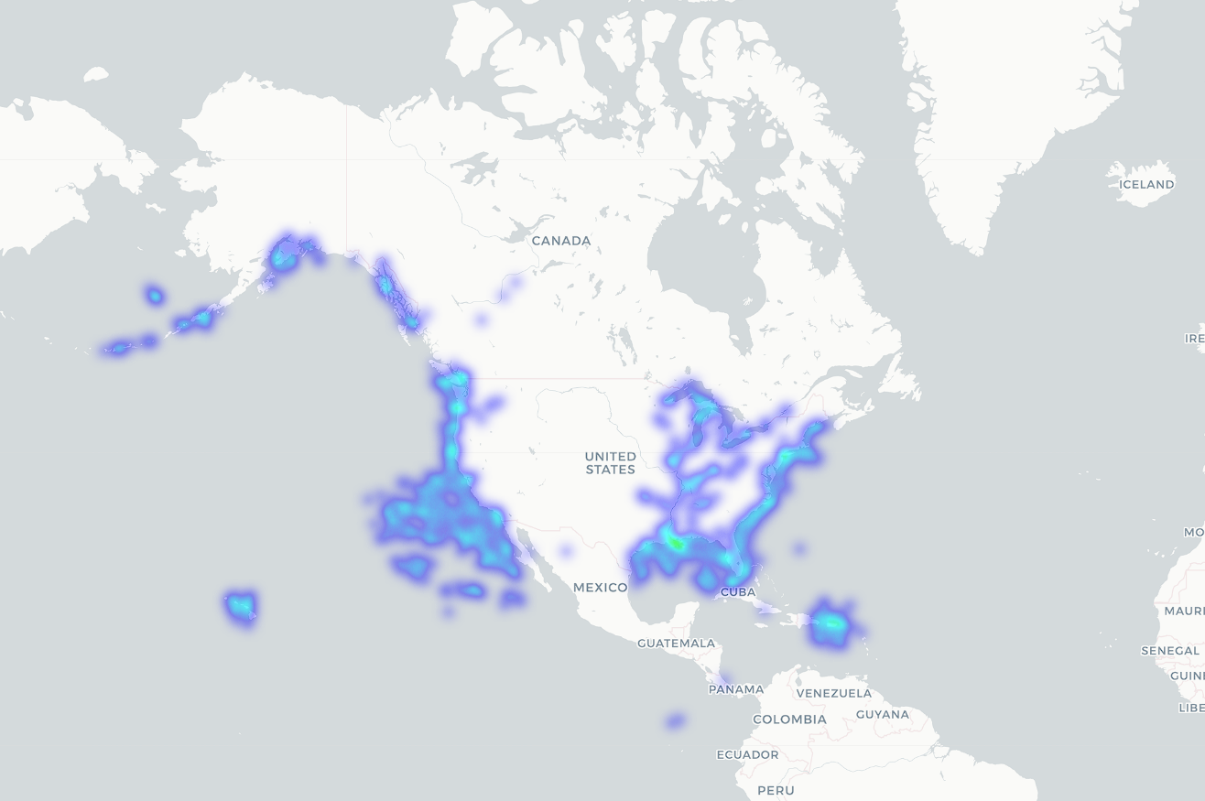
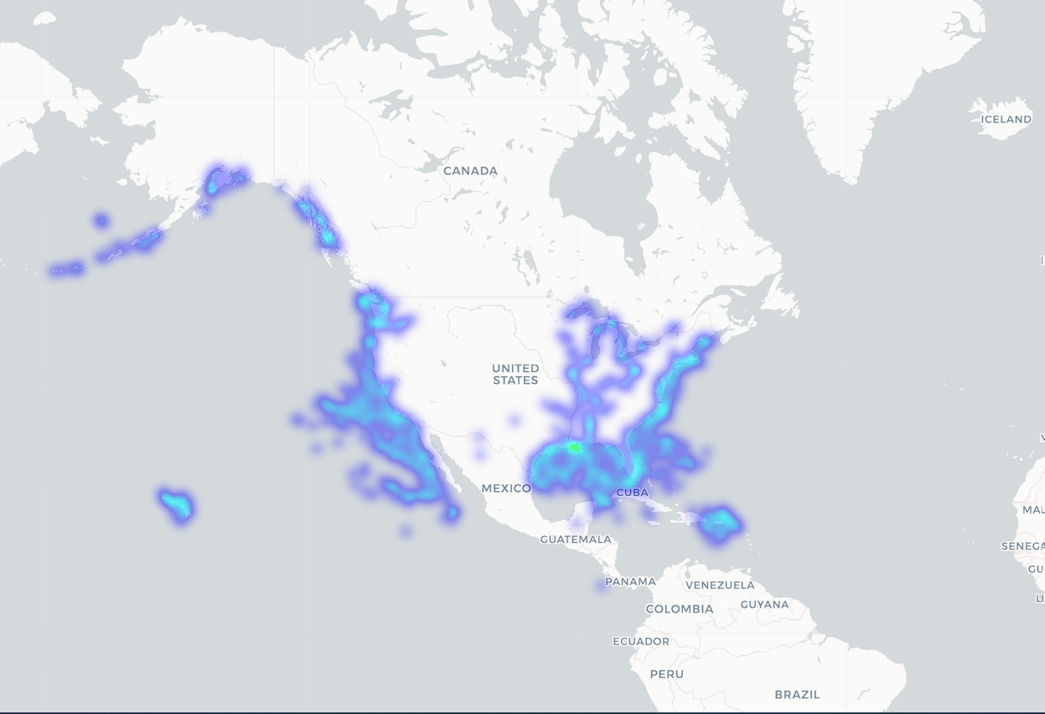
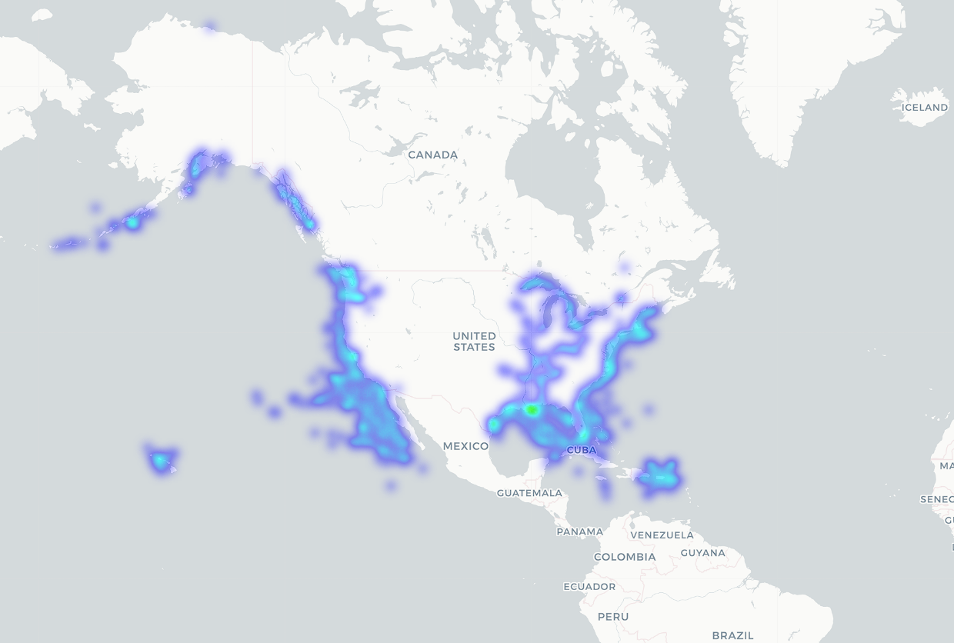
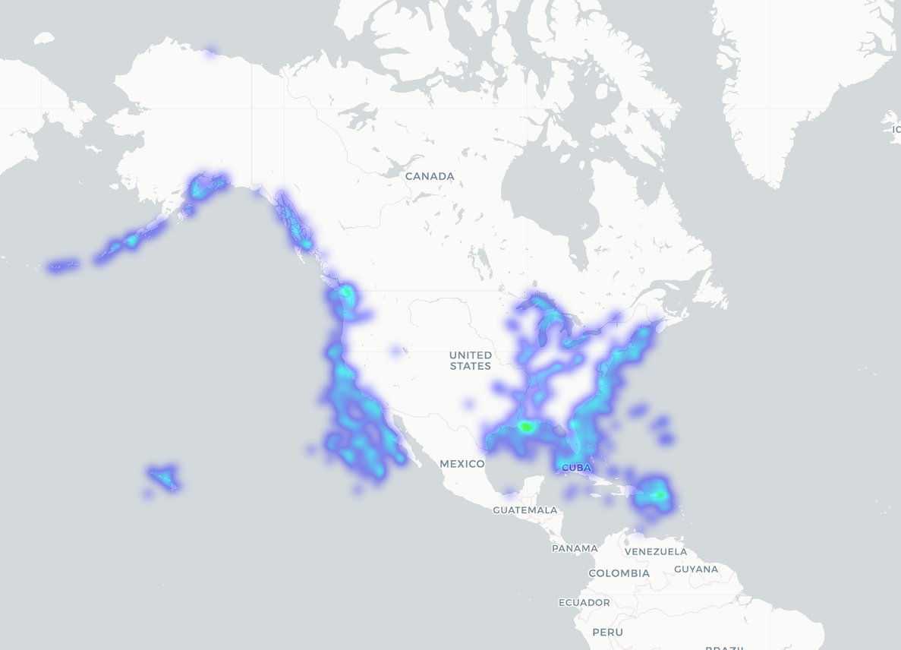
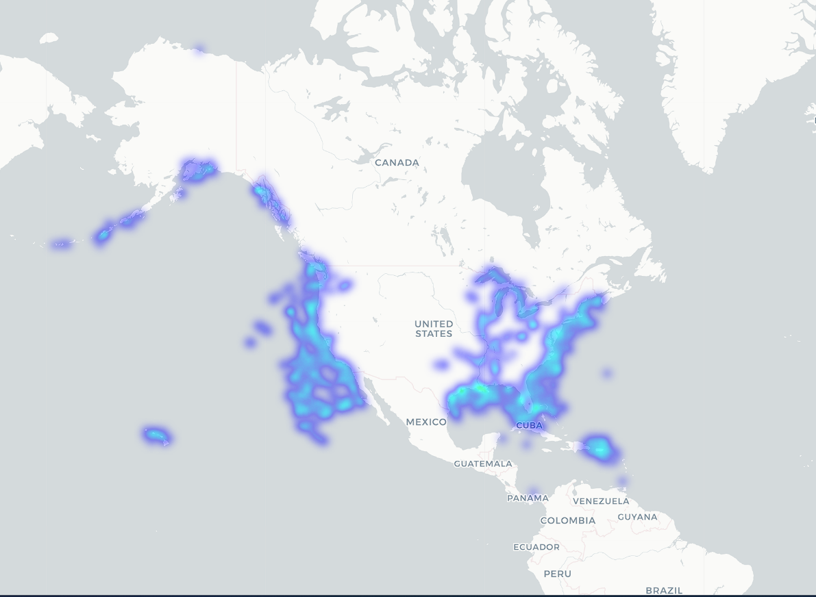
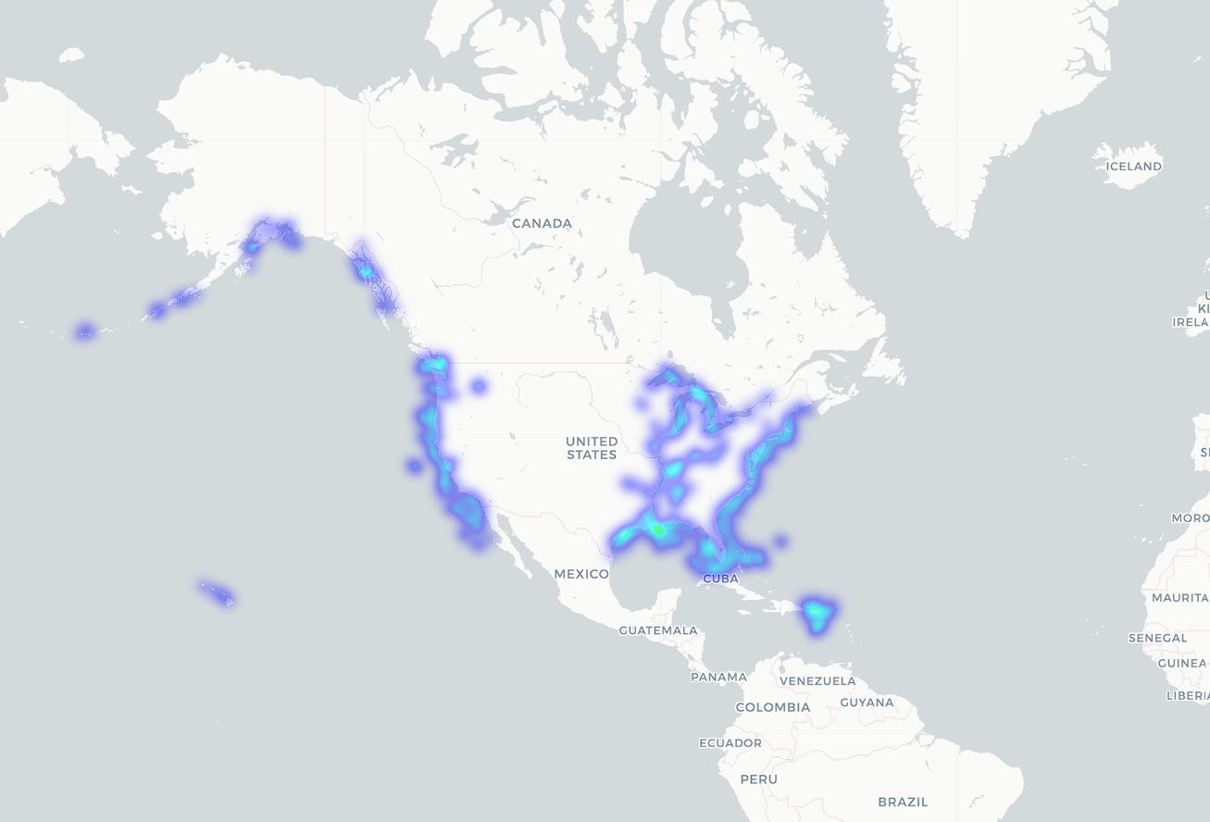
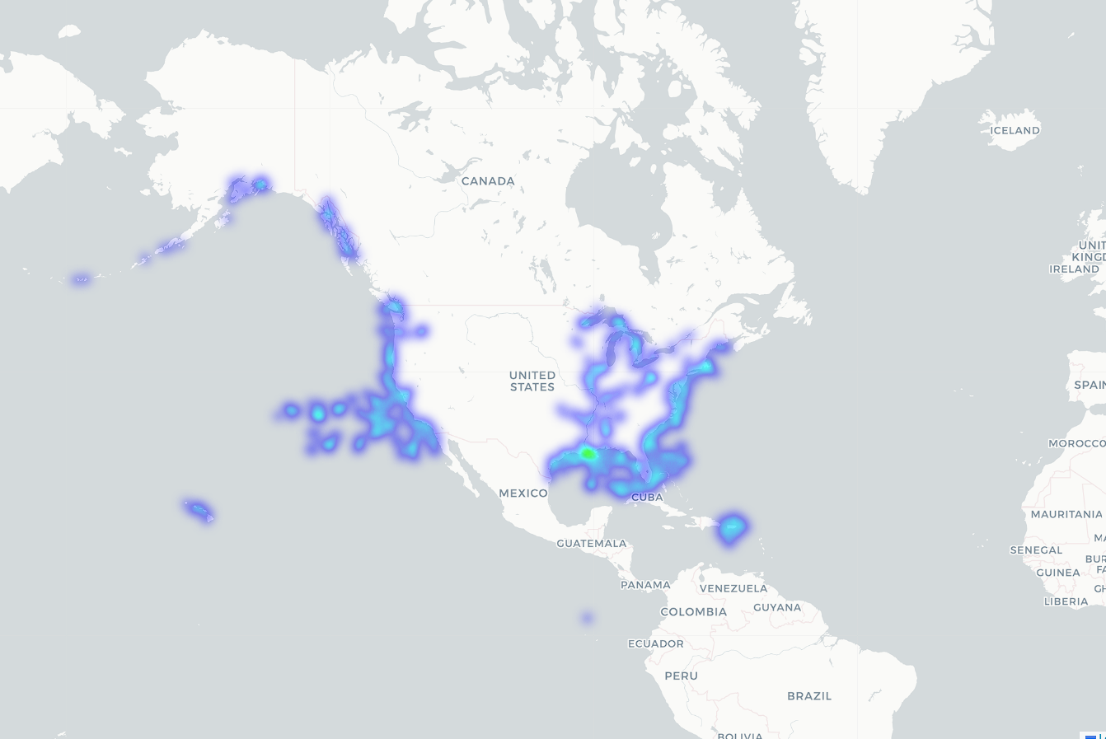
01st January 2020.
02nd January 2020.
03rd January 2020.
04th January 2020.
05th January 2020.
06th January 2020.
07th January 2020.

Slide 6

Objective :
Query: Show the last known position of INS Kolkata.{'intent': 'SHOW', 'vessel_name': 'ins kolkata', 'time_horizon': None, 'identifiers': {'mmsi': None, 'imo': None, 'call_sign': None}}
Query: Predict where MSC Flaminia will be after 30 minutes.{'intent': 'PREDICT', 'vessel_name': 'msc flaminia', 'time_horizon': 'after 30 minutes', 'identifiers': {'mmsi': None, 'imo': None, 'call_sign': None}}
Query: Check if the latest position of Ever Given is consistent with its past movement.{'intent': 'VERIFY', 'vessel_name': 'ever given', 'time_horizon': None, 'identifiers': {'mmsi': None, 'imo': None, 'call_sign': None}}
Query: Find vessel with MMSI 419999999.{'intent': 'SHOW', 'vessel_name': None, 'time_horizon': None, 'identifiers': {'mmsi': '419999999', 'imo': None, 'call_sign': None}}
Query: Verify CallSign AB1234 and IMO 1234567.{'intent': 'VERIFY', 'vessel_name': None, 'time_horizon': None, 'identifiers': {'mmsi': None, 'imo': '1234567', 'call_sign': 'AB1234'}}
NLP Model
Extract Features and Fetch the relevant data from the conversation. Intent: Vessel_name:
MMSI Number: IMO Number: Date – hour –minute – and parse the data according into json objects and search based upon Intent classified.
Sample Queries Taken during training.

Slide 7
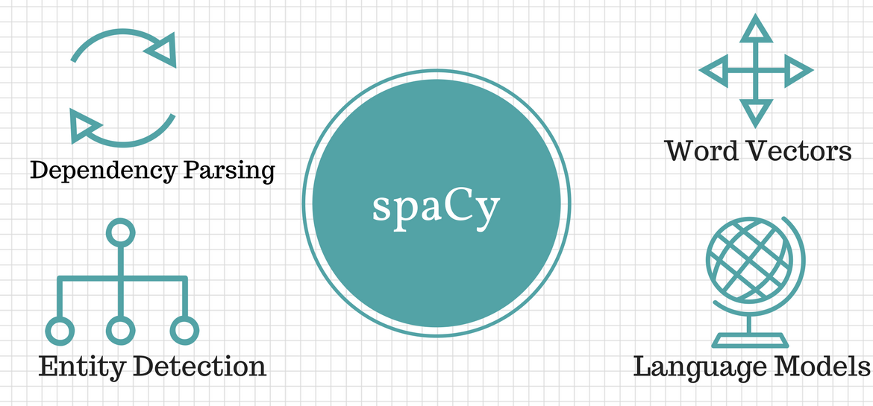
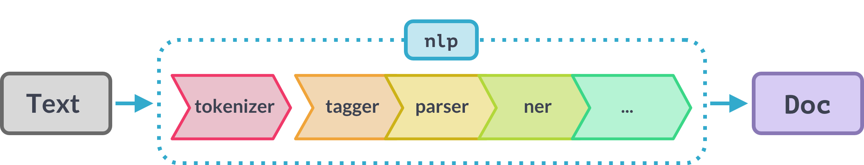
Natural Language Engine
spaCy is an open-source Python library for advanced Natural Language Processing (NLP) designed for speed and production use.
It provides pre-trained models and a framework to perform various NLP tasks like tokenization, part-of-speech tagging, named-entity recognition, dependency parsing, and building custom machine learning models.

Slide 8
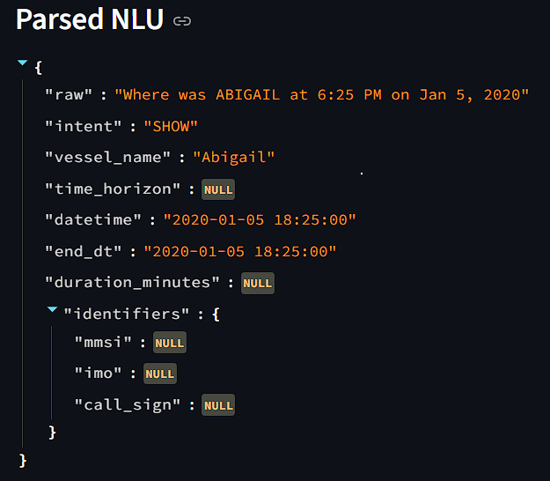

NLP- Engine Model for feature extraction from Natural Language conversation
Intent Recognition using Phrase Matching on Pretrained Vocab
Extracting Date-Time Horizon information from Conversation
Extracting custom Identifier MMSI , IMO, Call Sign from the conversation
queries = [
"Show the last known position of INS Kolkata.",
"Predict where MSC Flaminia will be after 30 minutes.",
"Check if the latest position of Ever Given is consistent with its past movement.",
"Find vessel with MMSI 419999999.",
"Verify CallSign AB1234 and IMO 1234567.",
]

Slide 9

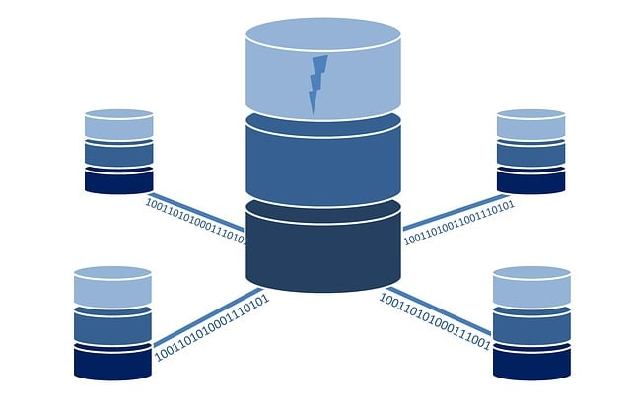


Complete Architecture Overview
Backed Database/ Cloud Server
Postgresql, mysql / API endpoint for real-time AIS data
User Query :
NLP Engine
Intent Recognition Entities Extraction
Time Horizon extraction
Identifier (MMSI, IMO etc) number extraction
Data- Base Handler
(db.py)
Creates dynamic sql queries , from the extracted conversations ---fetches all the relevant data.
Frontend
Retrieves the fetched data from the NLP Engine ----Chatbot response and shows real-time Plots on map.

Slide 10
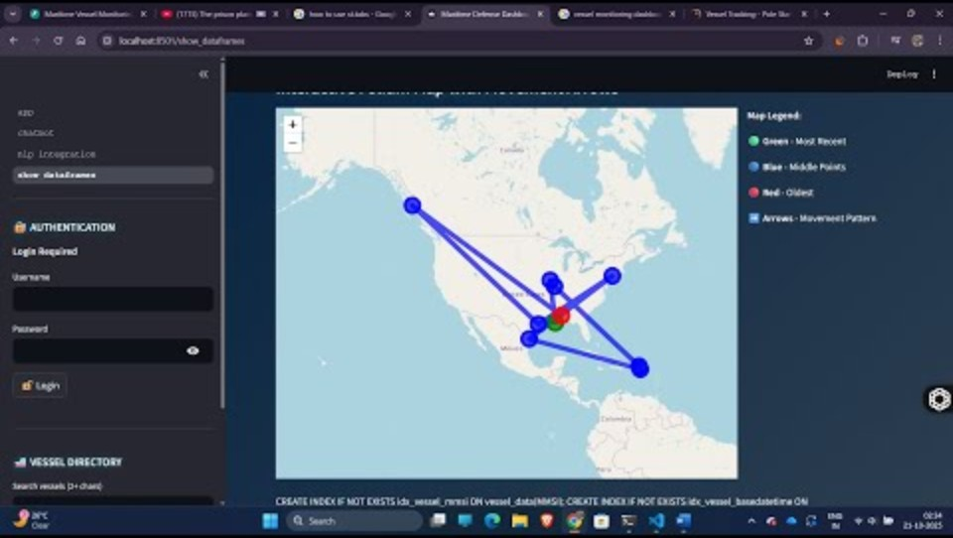
Preview of Prototype Dashboard

Slide 11
Machine Learning – Deep Learning Pipeline for Time Series Vessel Trajectory Forecasting

Slide 12
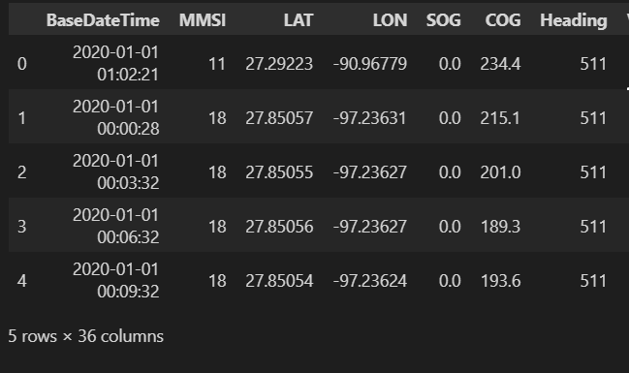
Data Preprocessing and Feature Engineering
Data Cleaning :
1. Removed all those instances of MMSI – number where count is less than 50 . Time series modelling requires longer sequential data. 2. Clear all the rows where there are no Vessel Name – i.e Unknown Vessels.
3. Removed Length, width , height columns as not significant for predictive modelling. Preprocessing: 1. Convereted base Date time column to date-time object and extract hour:minute , day , month etc details for seasonality modelling.
2.Sequentially arranged our data-frame from start time step to end timestep . Very Important for Time Series ML pipeline that your data are sequentially arranged at 1 min interval timestamp.
3. Polynomial interpolation for midpoints between 2 consecutive interpolation.

Slide 13
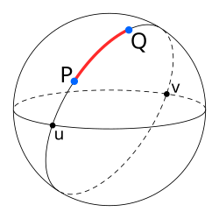
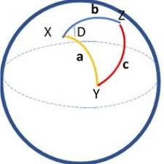
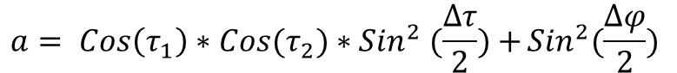
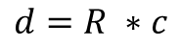
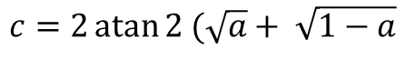
Haversine Distance Calculation for Geodesic Feature Addition
The haversine formula determines the great-circle distance between two points on a sphere given their longitudes and latitudes.
Calculate Intermediate value a:
$$a= Cos\left(τ_{1}\right)∗Cos(τ_{2})∗{Sin}^{2} (\frac{∆τ}{2})+{{Sin}^{2}(\frac{∆φ}{2})}$$
Calculate Central Angle C:
$$c=2\operatorname{atan}{2 (\sqrt{a}+ \sqrt{1−a}}$$
Where R = 6371km , radium of earth(taken as mean).
Calculate distance d :
$$d=R ∗c$$
Note: Adding Haversine Distance calculation helps the model to create new feature engineered data – Which helps increase the model parameters.

Slide 14
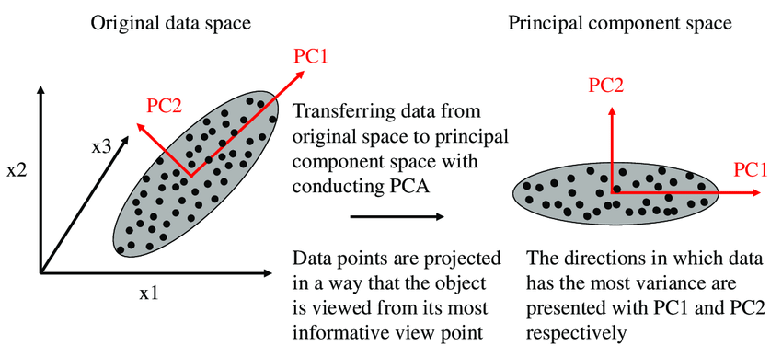
Feature Engineering with Principal Component Analysis (PCA)
PCA works in feature engineering , by transforming original data into a smaller set of new , uncorrelated features called principal components.
It achieves this by finding the directions of maximum variance in the data and projecting the data onto a new, lower-dimensional space defined by these principal components. This process reduces dimensionality, removes redundancy, and creates a more interpretable and efficient dataset while preserving most of the original information.
Advantages of PCA:
Dimensionality reduction: Reduces the number of features in a dataset, which can improve model performance and reduce computational costs.
Removes redundancy: Combines highly correlated features into new, independent components, which can simplify the data and prevent issues like multicollinearity in models.
Feature extraction: Creates new, more meaningful features (principal components) that capture the most important information from the original data

Slide 15
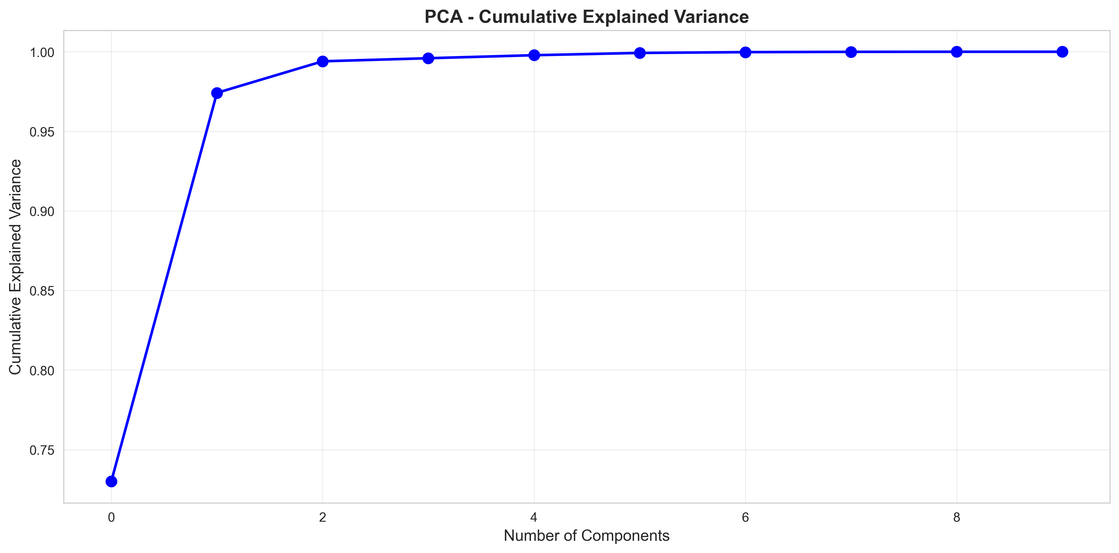
Cumulative explained variance is the sum of the explained variance ratios for the first few principal components in a Principal Component Analysis (PCA).
It indicates how much of the total variability in the original dataset is captured by a selected number of components.
This metric is crucial for dimensionality reduction, as it helps in deciding how many components to retain to simplify the data while preserving most of its information.
Threshold cummulative variance = 0.95

Slide 16
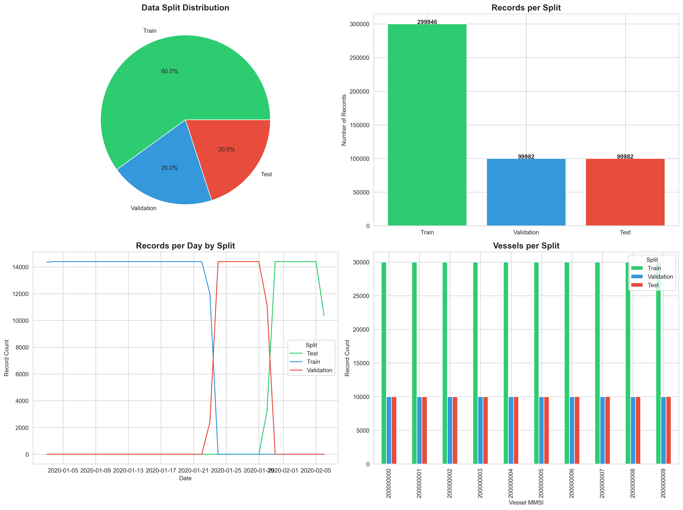
Machine Learning Models used for Predictive vessel Monitoring
Base LSTM Model
LSTM with Kalman Filter
Tiny LSTM with more layers.
Neural Network Regressor
XGBoost Regressor
Random Forest Regressor

Slide 17
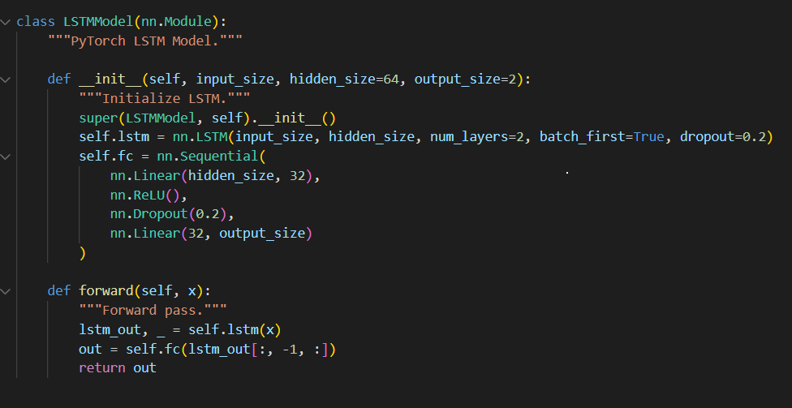
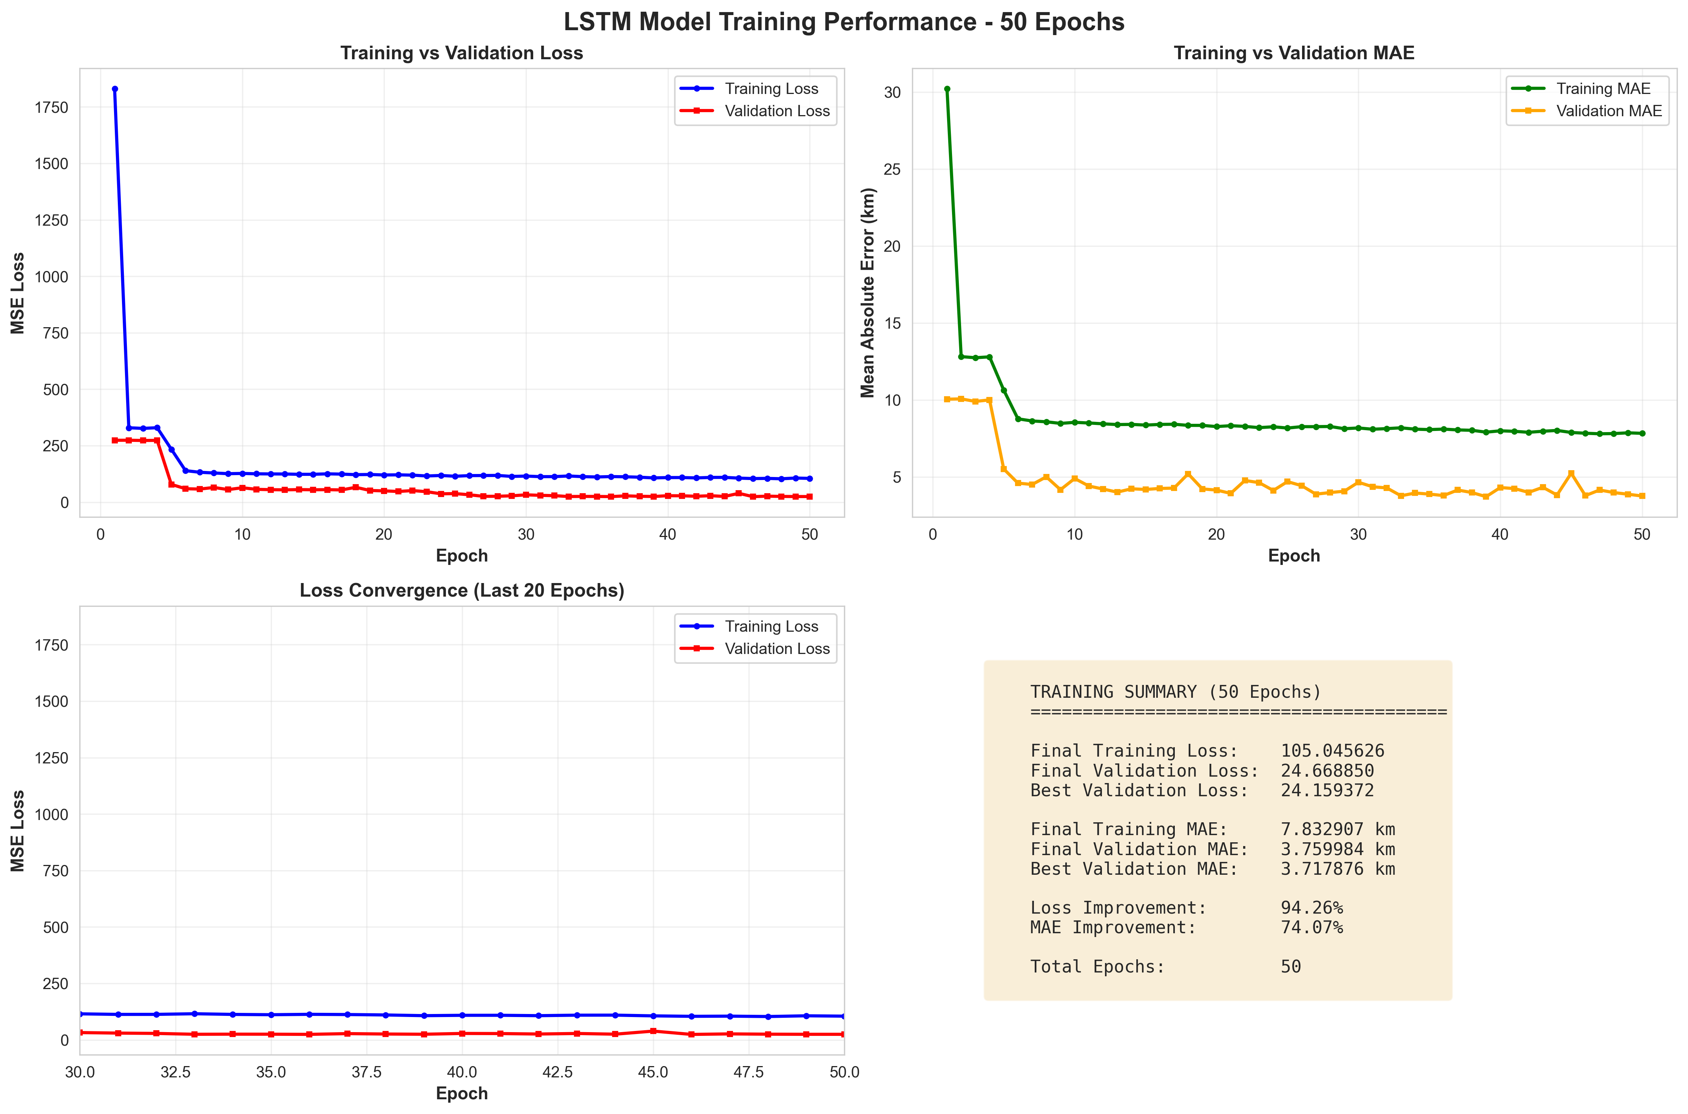
Base LSTM Model Performance – Without Feature Engineering

Slide 18
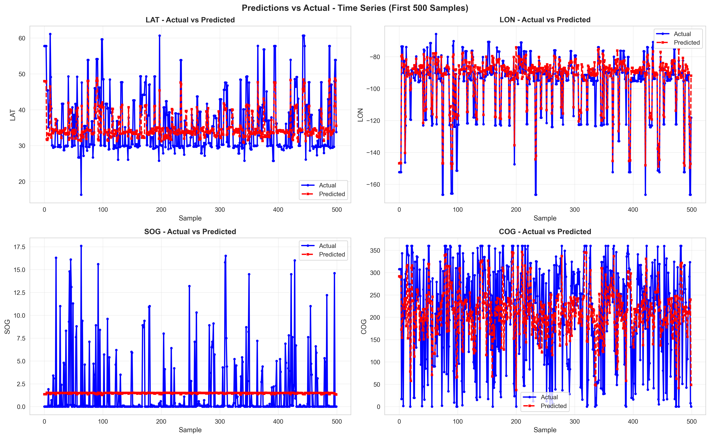
Base LSTM Model Performance – Without Feature Engineering
Sample prediction on the first 500 samples from the test data.

Slide 19
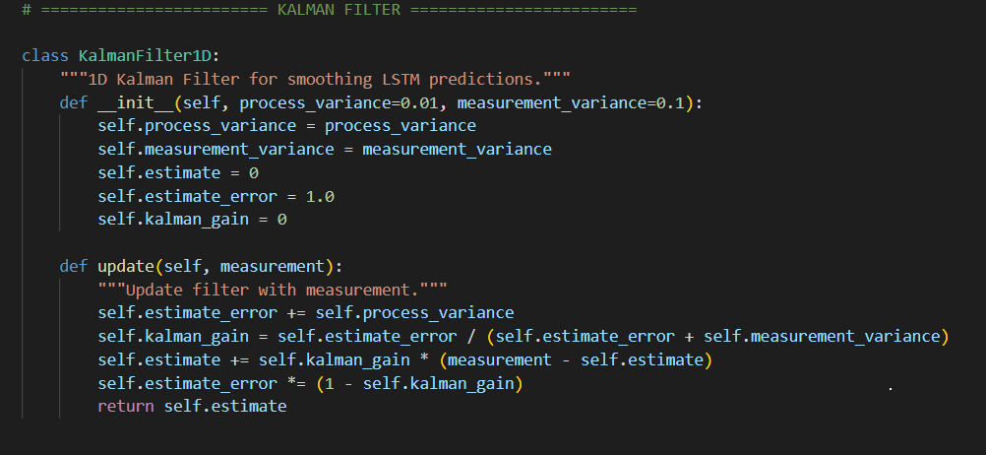
Maintains two uncertainties:
Process variance (Q): how much the system’s state changes over time.
Measurement variance (R): how noisy the observations are.
For each new measurement:
Predict: Increase the estimate error slightly (+ process_variance).
Update: Compute Kalman Gain = how much to trust measurement vs prior estimate.
Correct: Adjust the estimate toward the measurement.
Refine: Reduce uncertainty based on how much correction was applied.
Advantage: Provides adaptive smoothing — automatically balances noise reduction and responsiveness without needing a fixed smoothing window like moving averages.
LSTM with Kalman Filters :
This hybrid Kalman-LSTM setup enhances vessel trajectory forecasting by combining the pattern-learning capability of LSTMs with the stability and noise suppression of Kalman Filters.

Slide 20
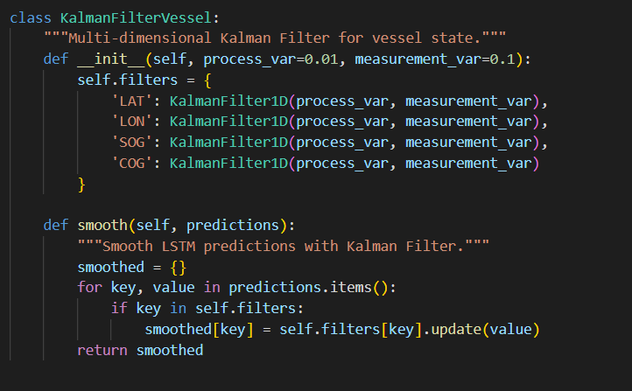
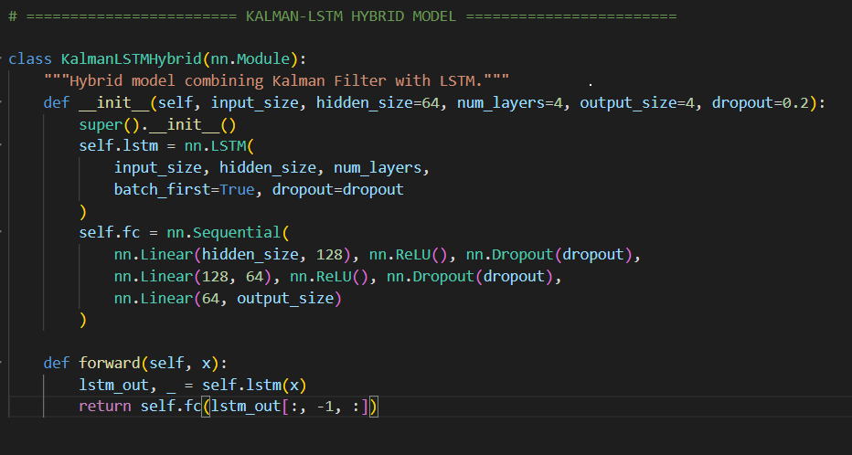
Multi-dimensional Kalman Smoothing
Each variable is smoothed independently — reducing noise in position and velocity estimates, leading to more stable and realistic vessel trajectories after LSTM prediction.
Kalman_LSTM Model: Learns temporal dependencies from vessel time series (e.g., past positions/speeds).
Fully Connected Layers: Map hidden representations to 4 outputs (LAT, LON, SOG, COG).
Post-processing: Kalman filter smooths these outputs to remove short-term prediction noise.
Advantage:
LSTM: Captures complex nonlinear temporal behavior.
Kalman Filter: Stabilizes predictions by filtering random fluctuations.
Robust, smooth, and physically realistic vessel trajectory forecasts.

Slide 21
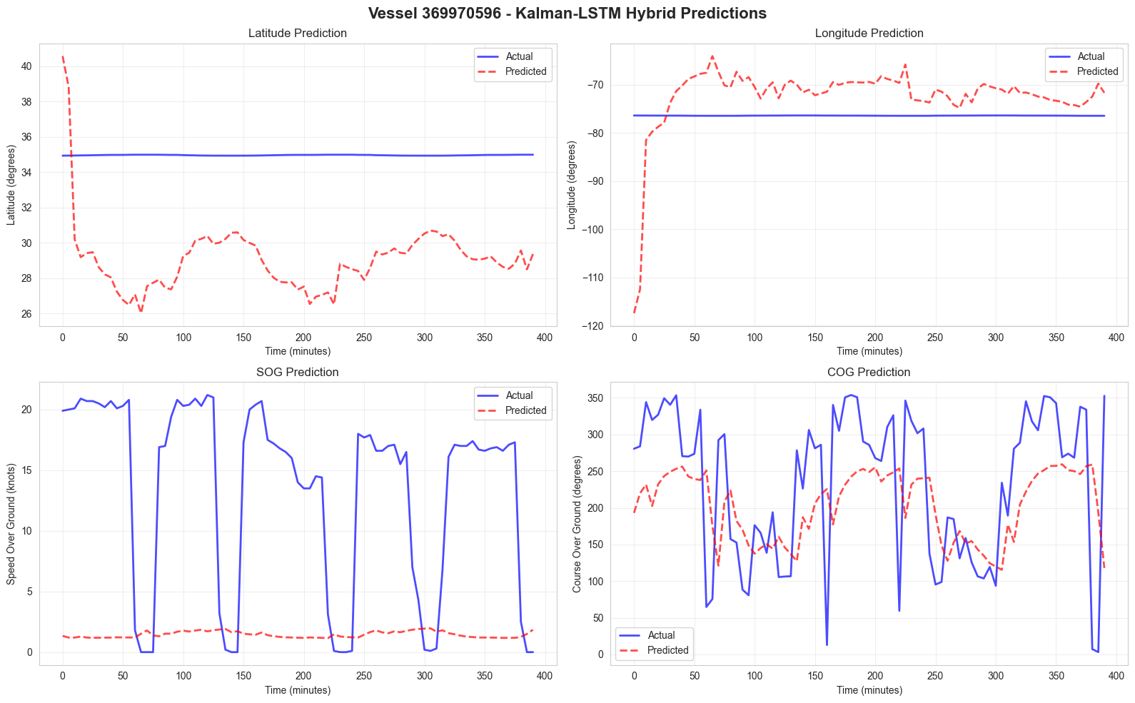
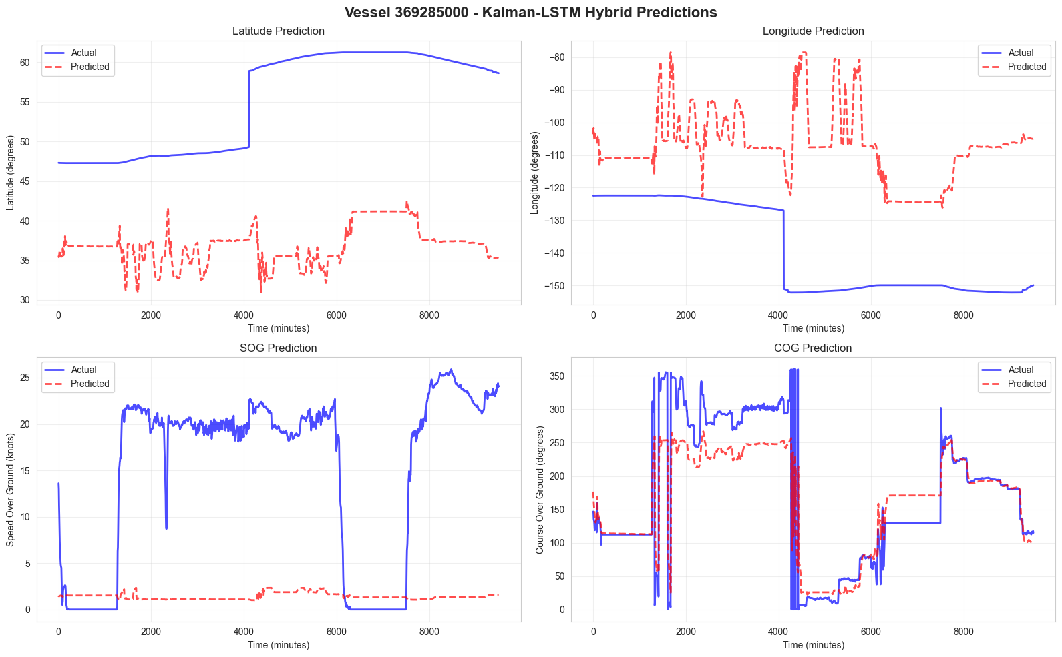
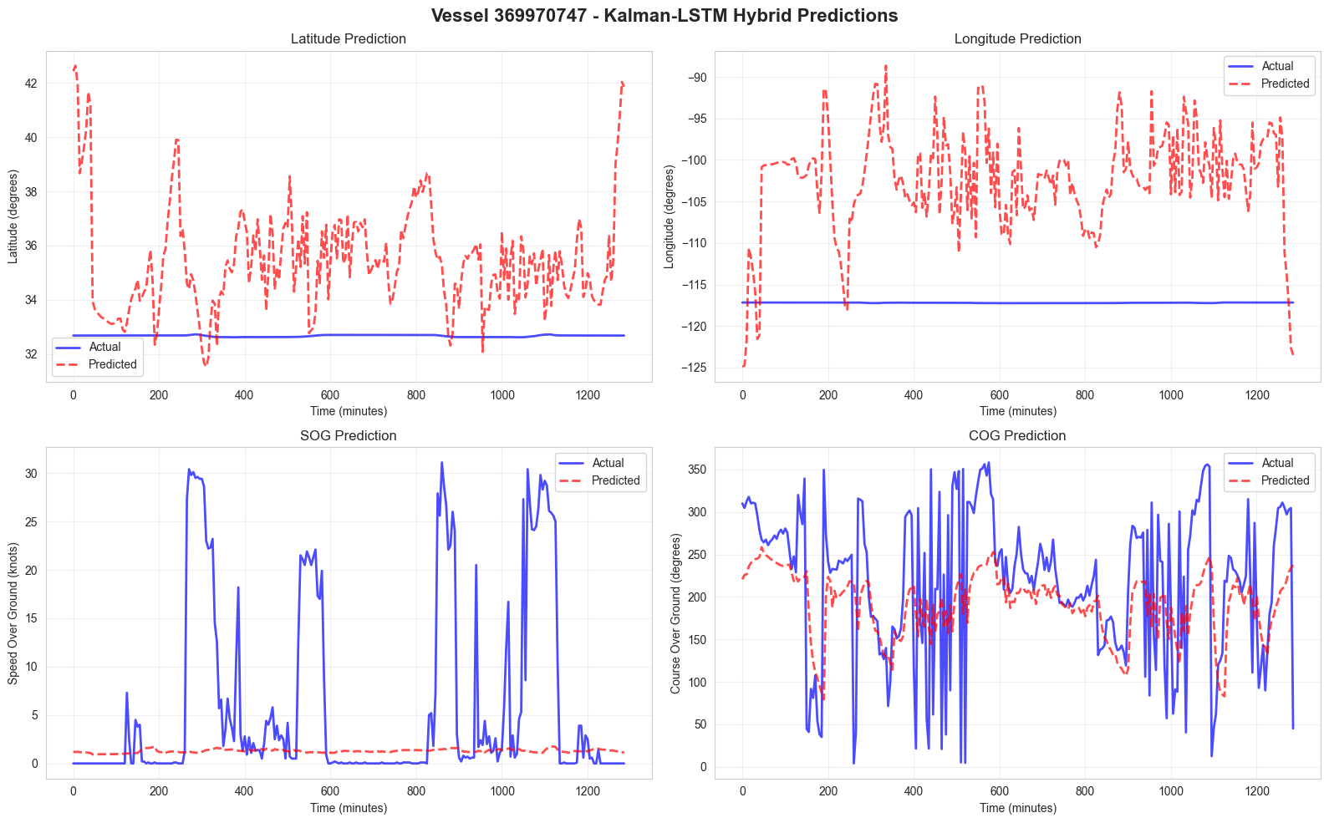
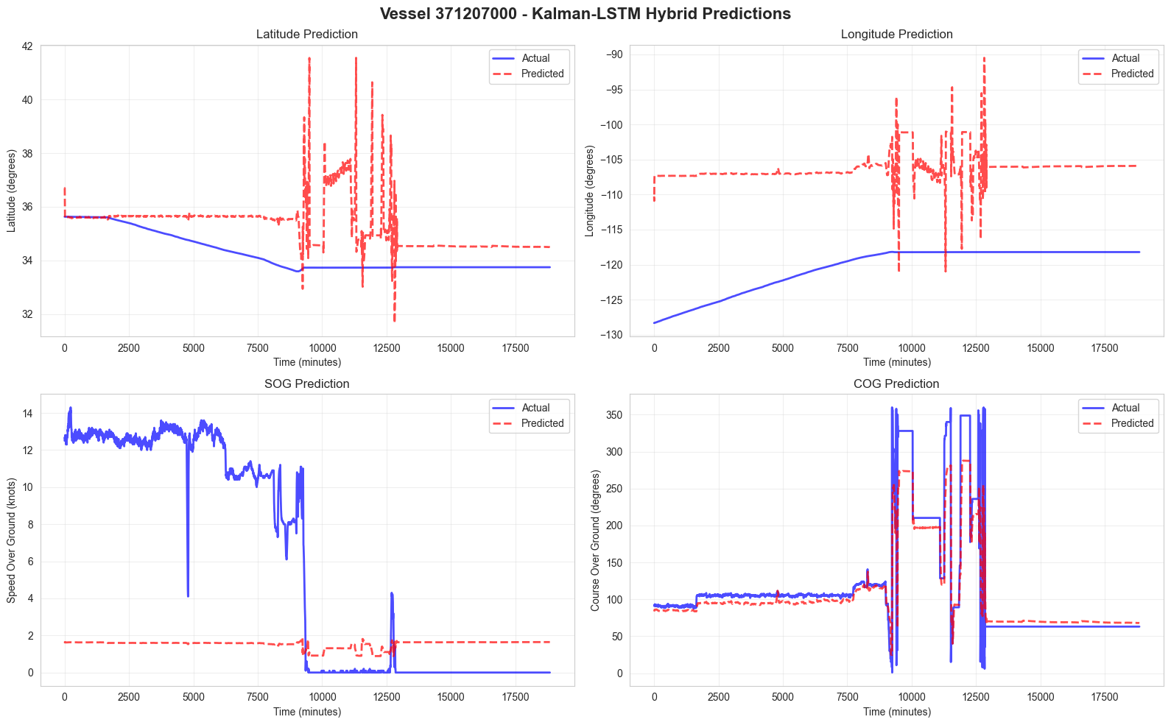
Prediction on Random Vessel Trajectories using LSTM_Kalman Model:

Slide 22
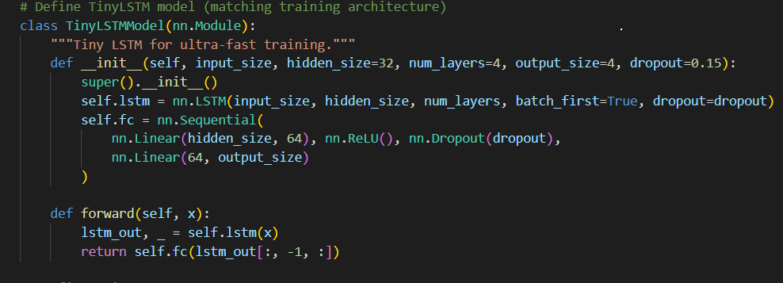

Slide 23
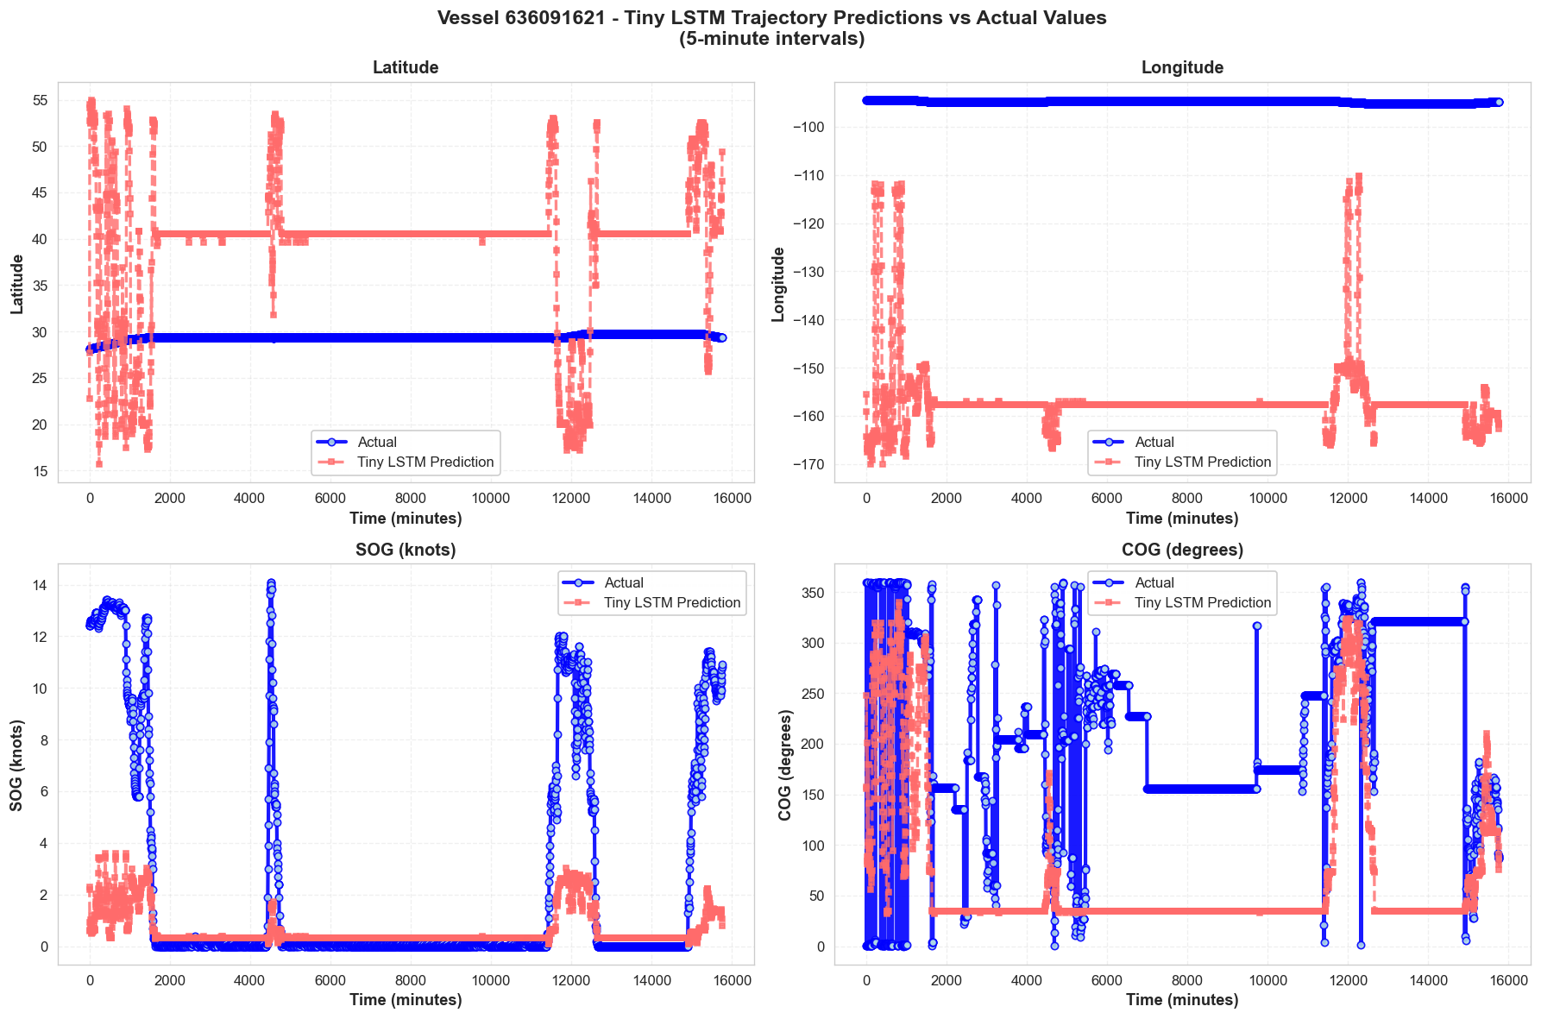
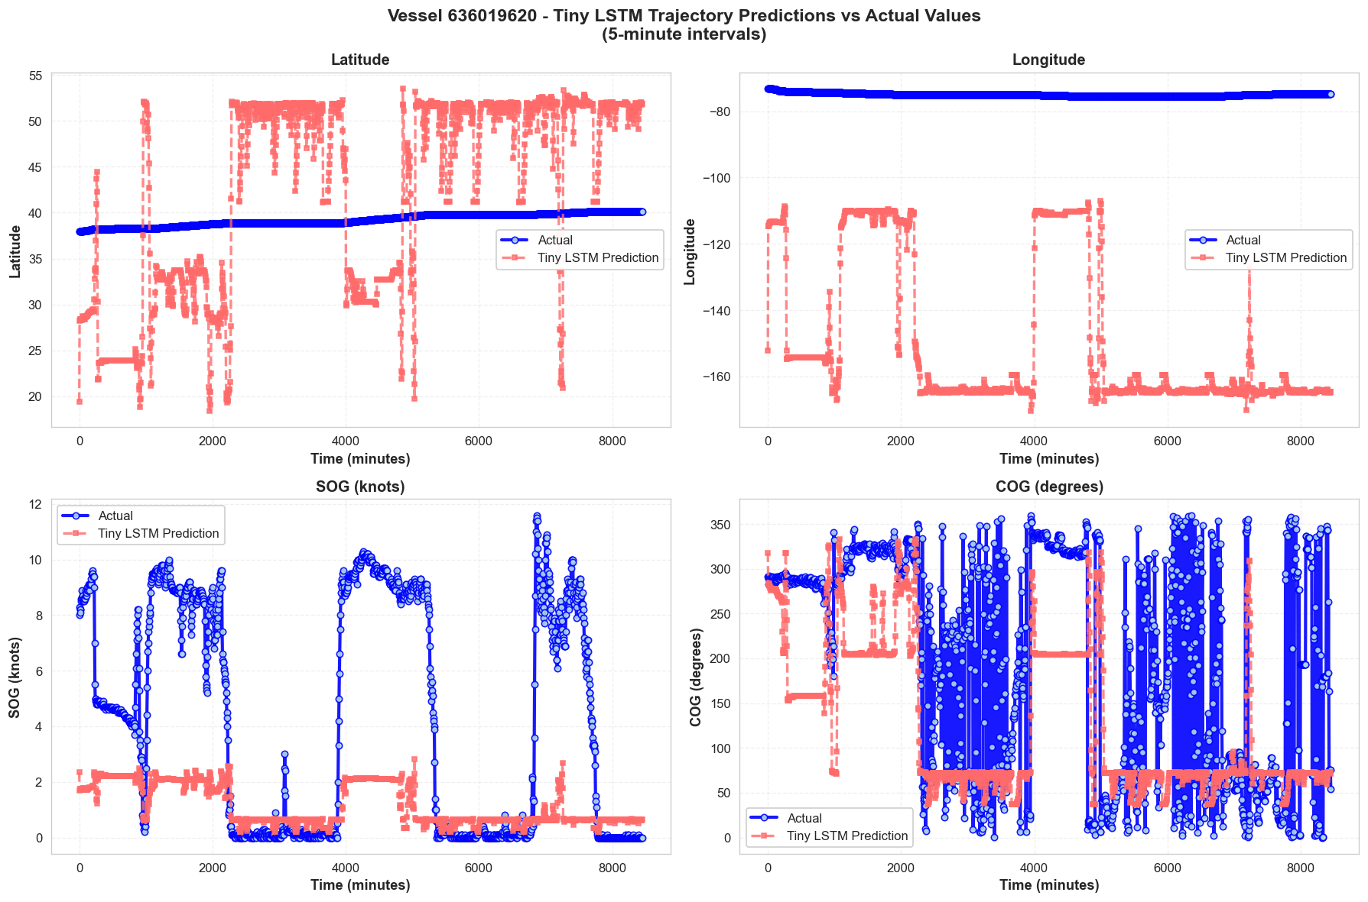
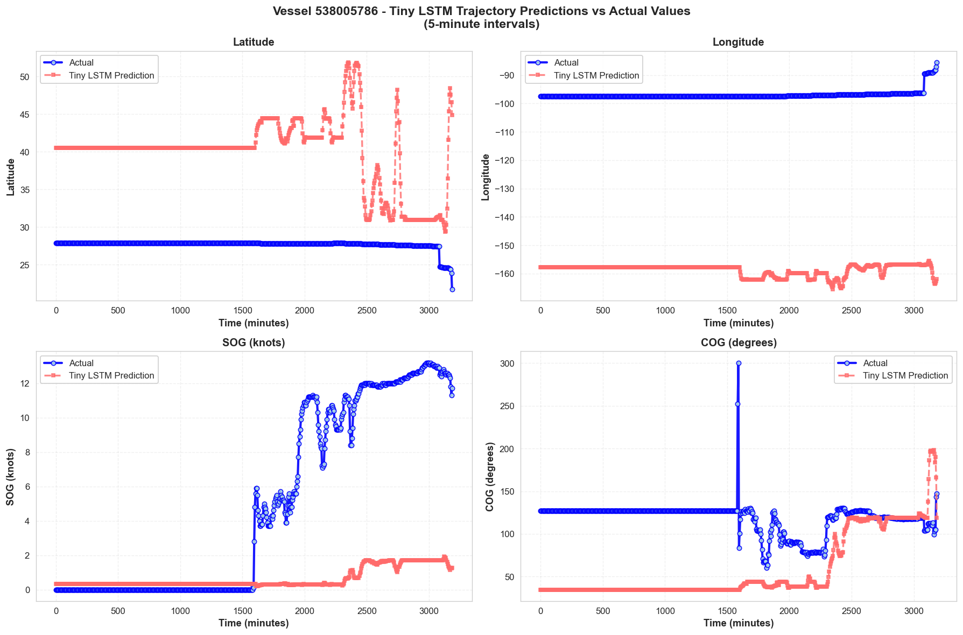
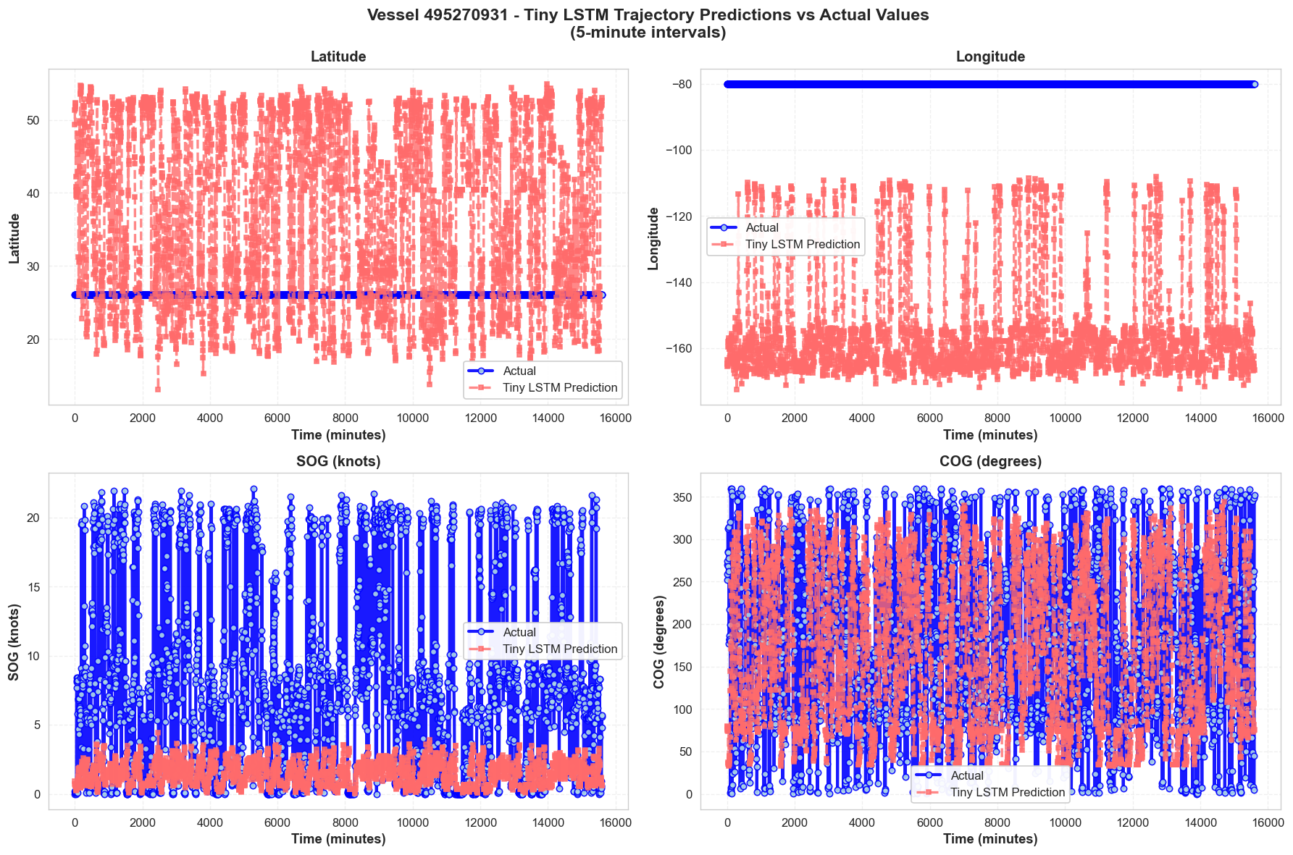
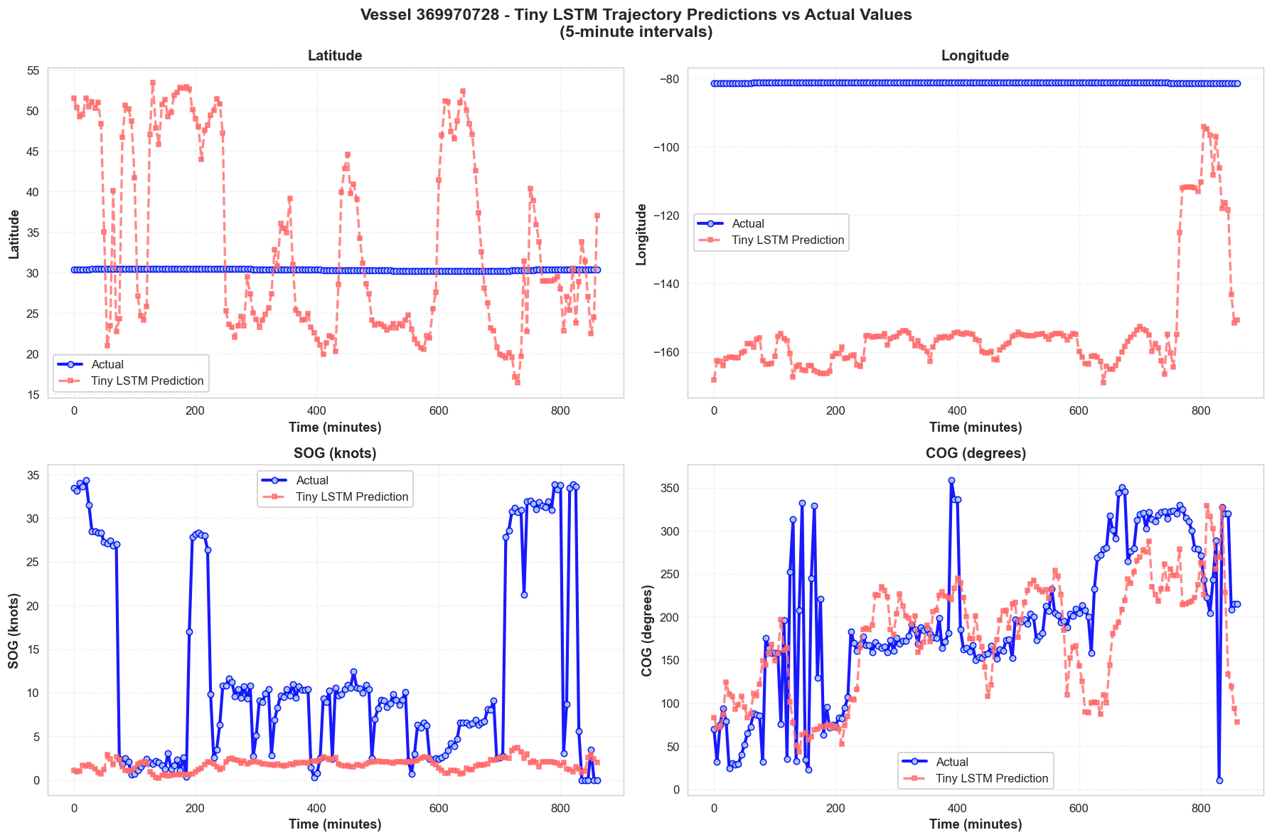

Slide 24
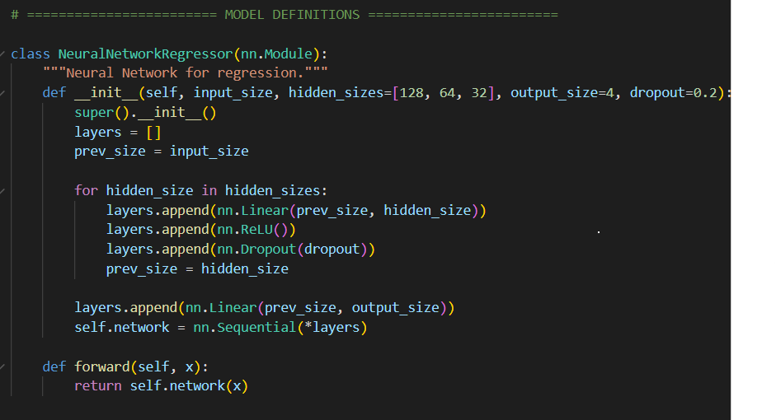
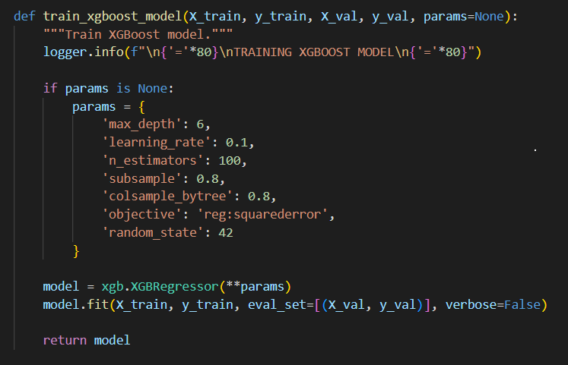
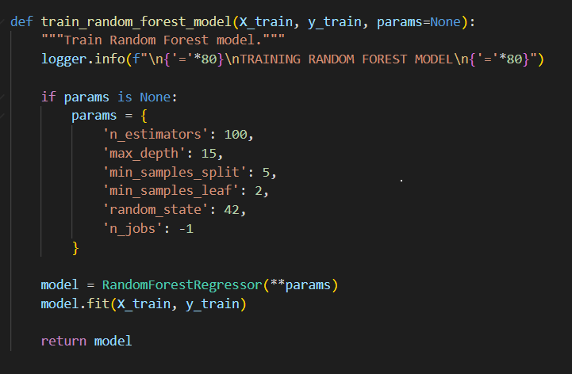
Neural Network Regressor / XGBOOST / Random Forest Model Architectures

Slide 25
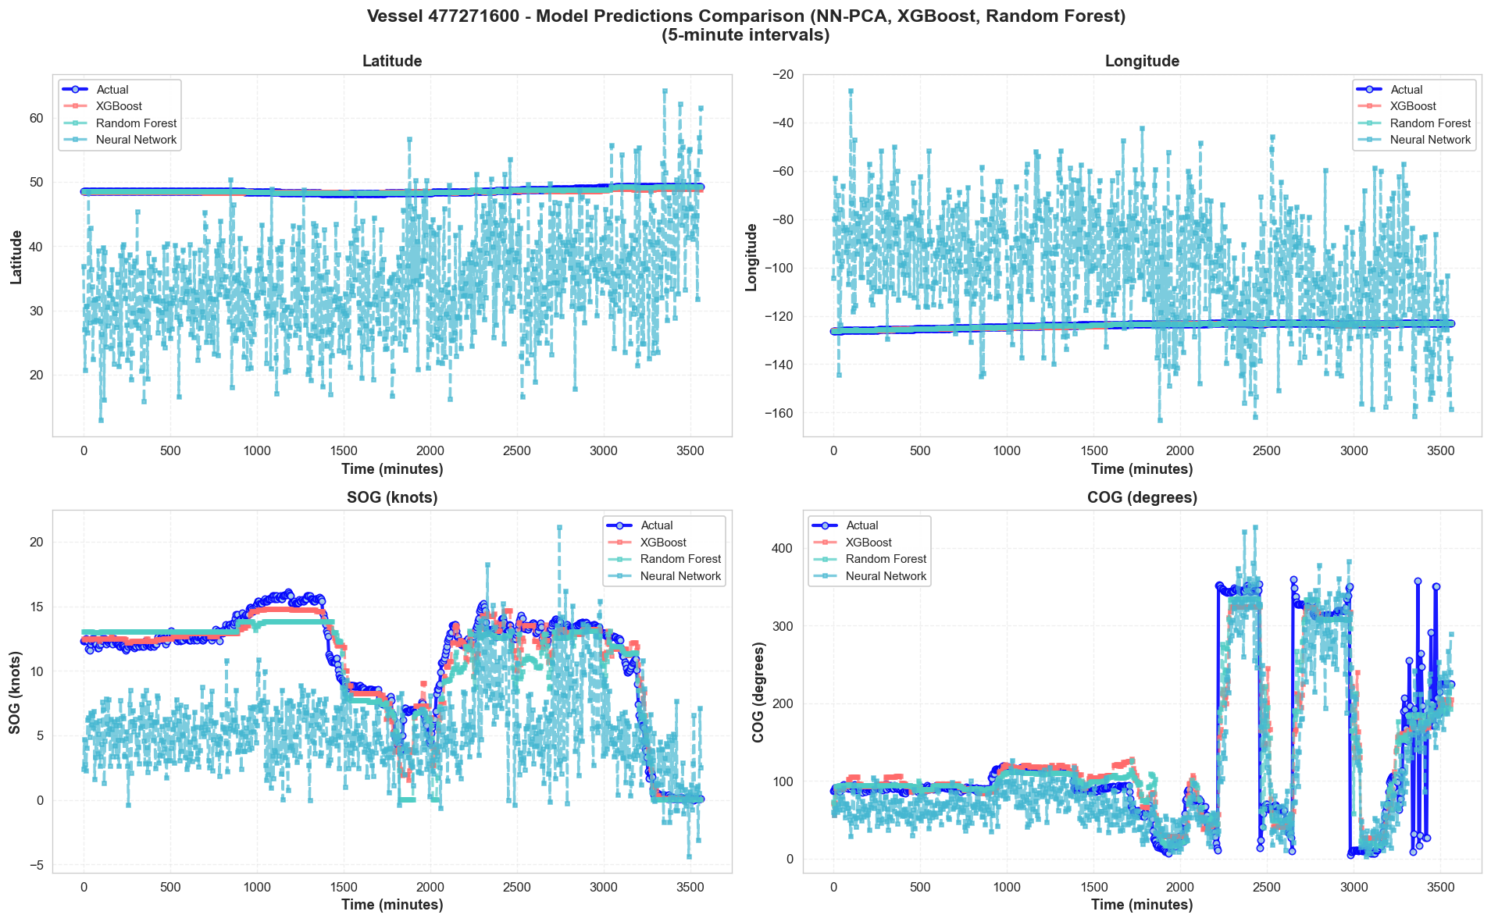
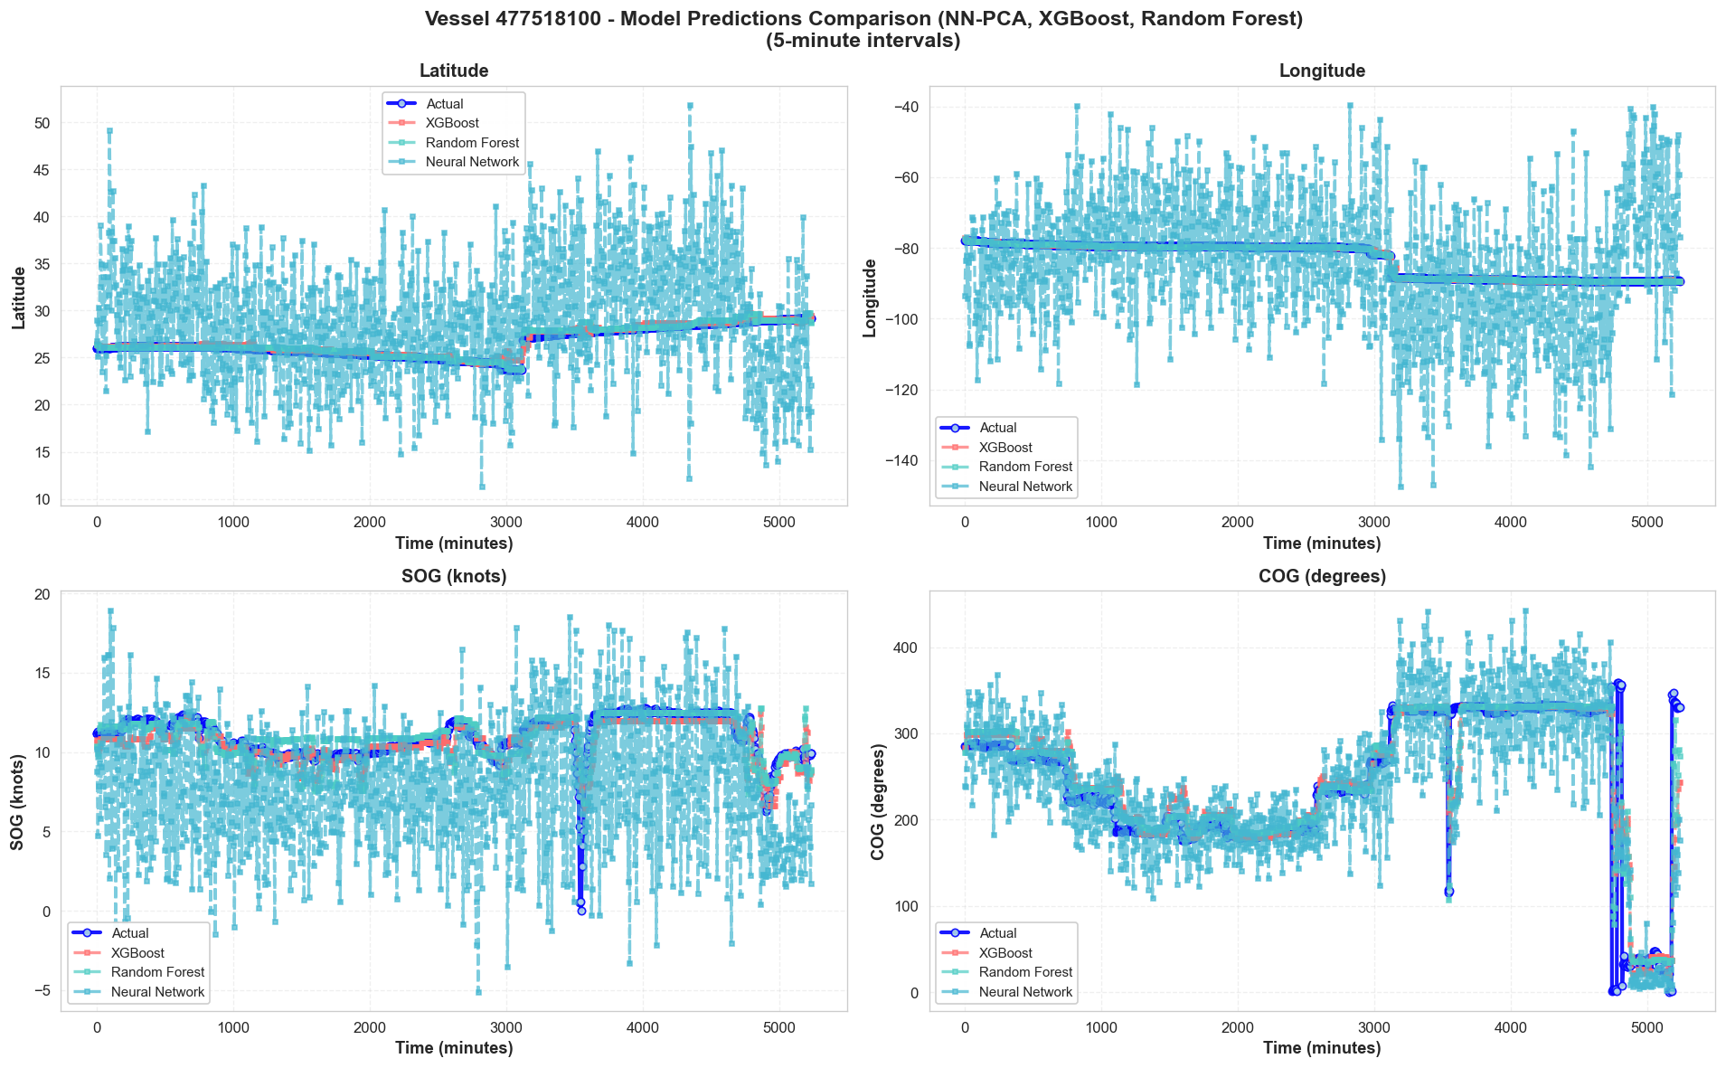
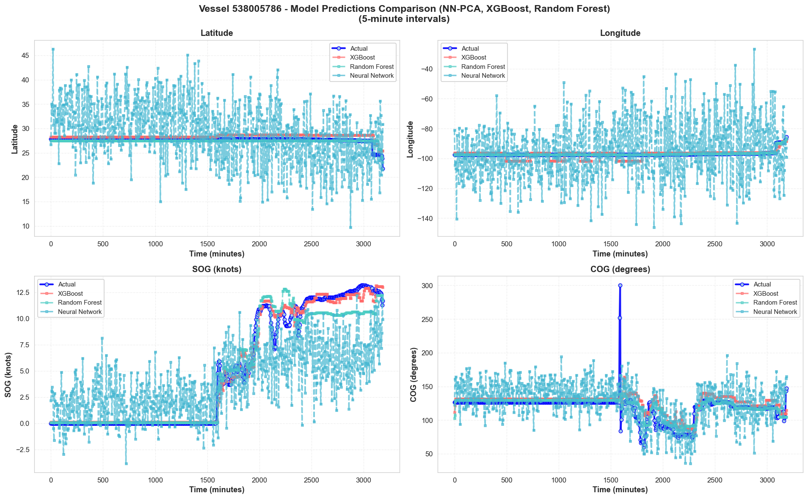
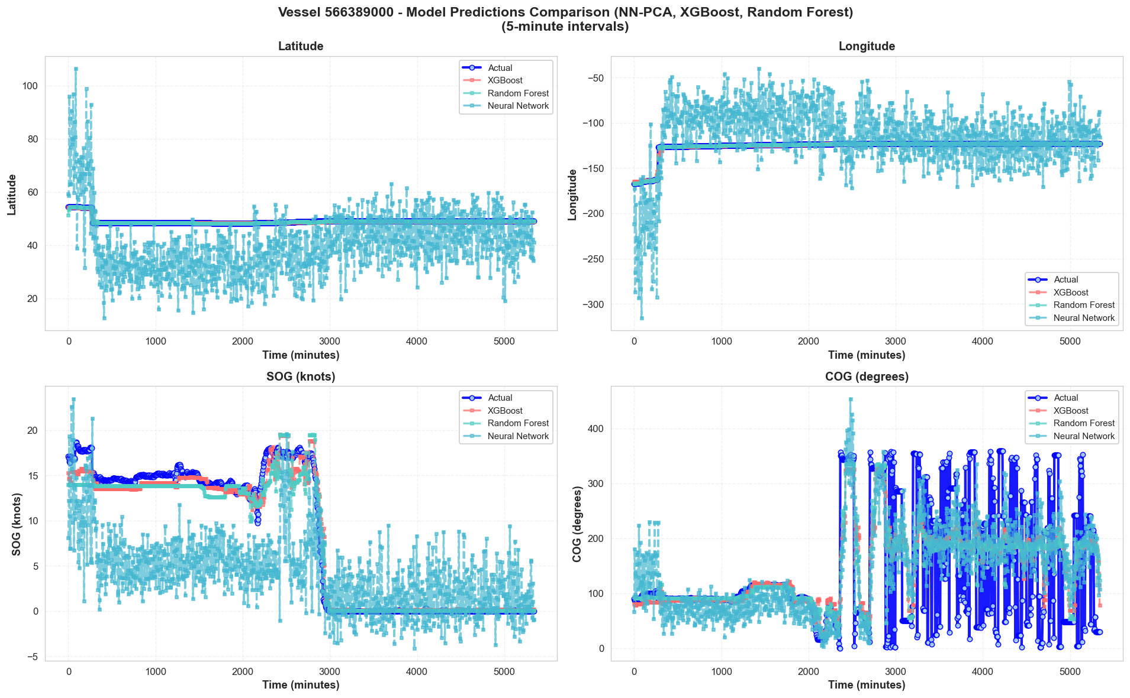
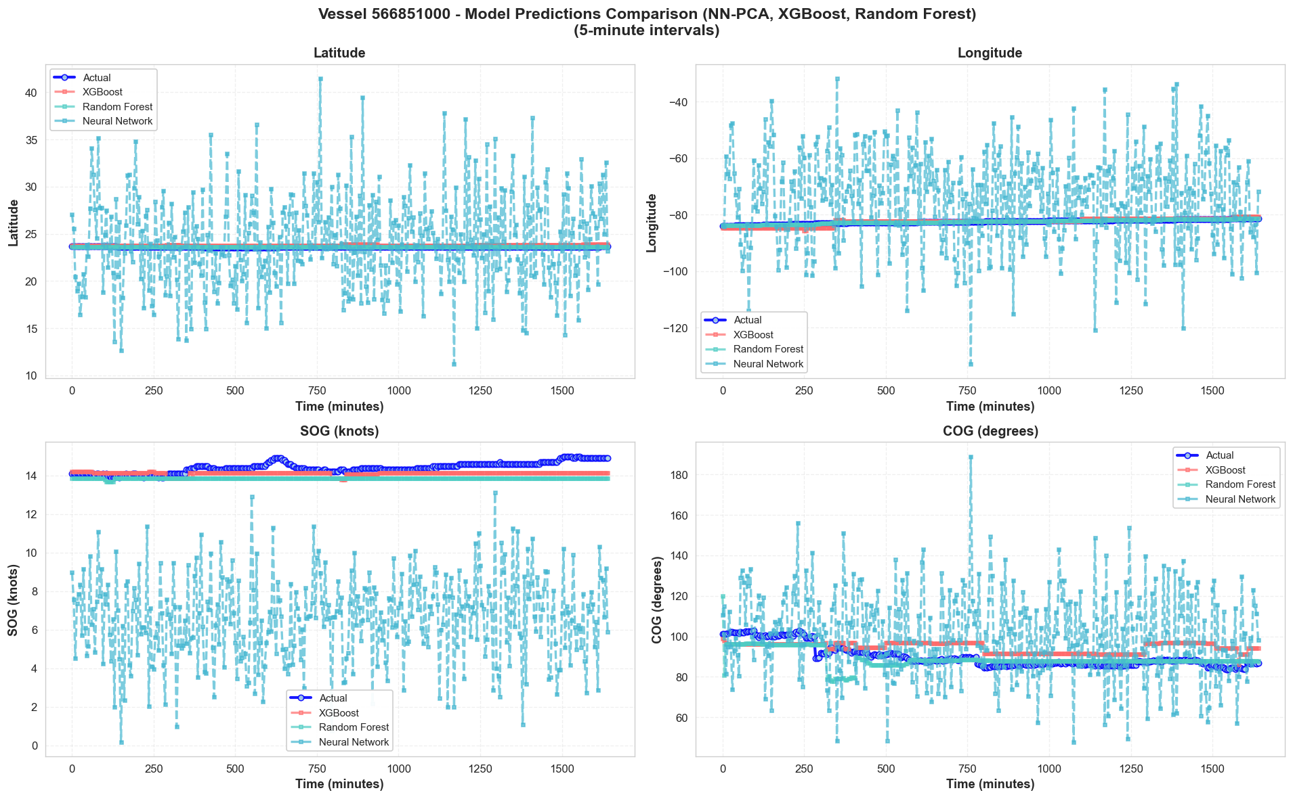
Comparison of Trained Model’s Trajectory Prediction using NN-Regressor, XGBOOST and Random-Forest Regressor

Slide 26
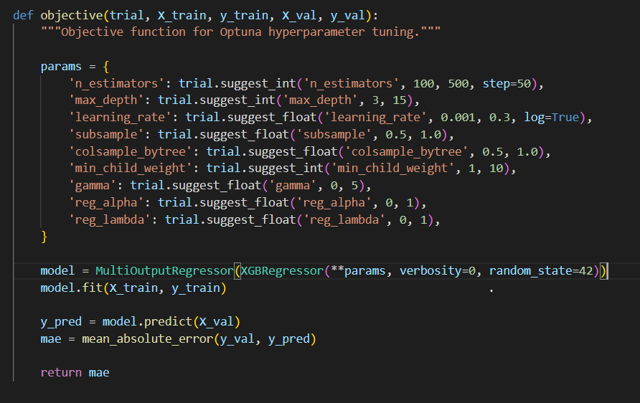
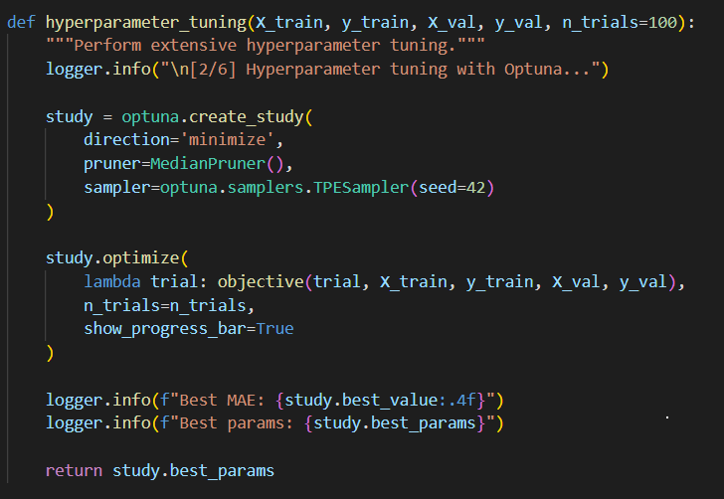
Extensive Hyperparameter tuning on XGBOOST for best fit– Model using Optuna

Slide 27
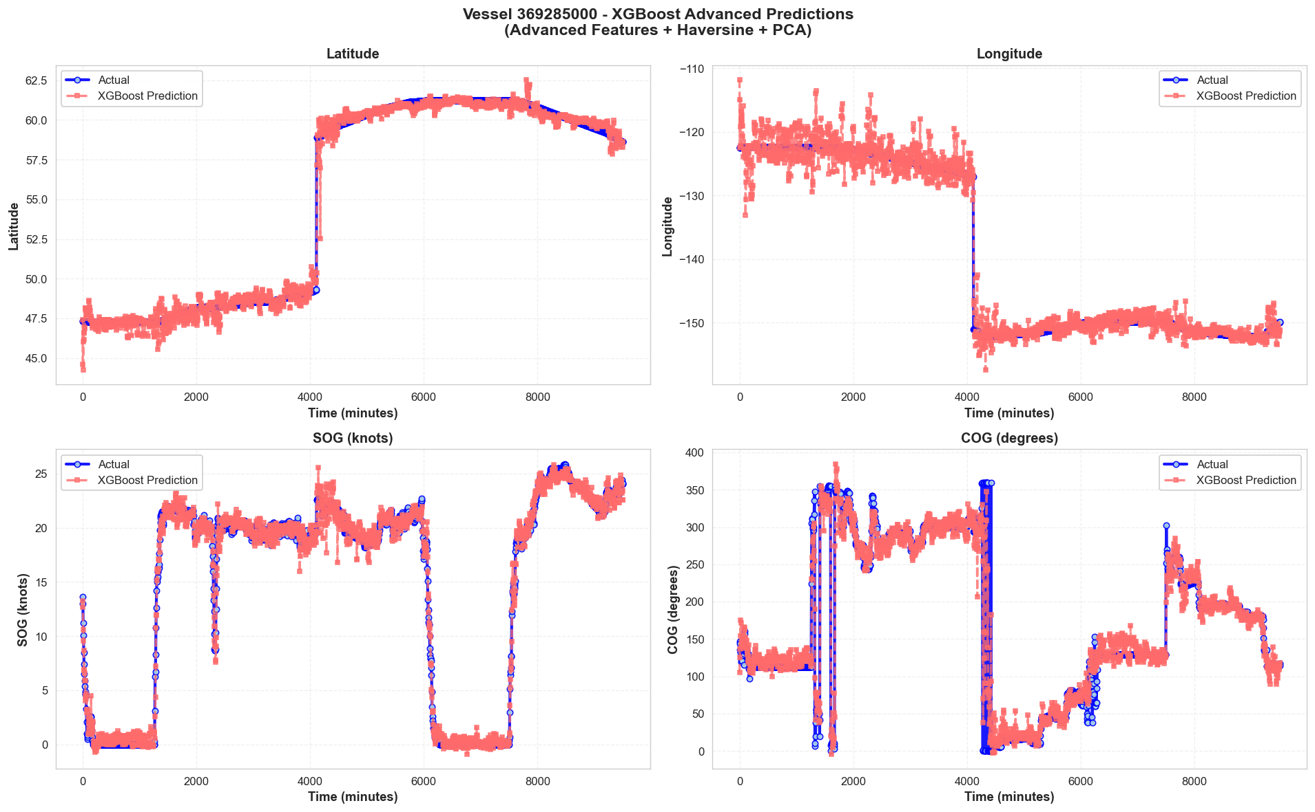








Best Fit Model Trajectory Prediction

Slide 28
Future Work:
1 . Integration of Predict and Verify API endpoints to the frontend. 2. PyCute – GUI for better graphical visualization. 3. Cloud compute – GPU / TPU services for BigData Handling. 4.Integration with whether data and other data for more robust feature engineering.

